Slide 1
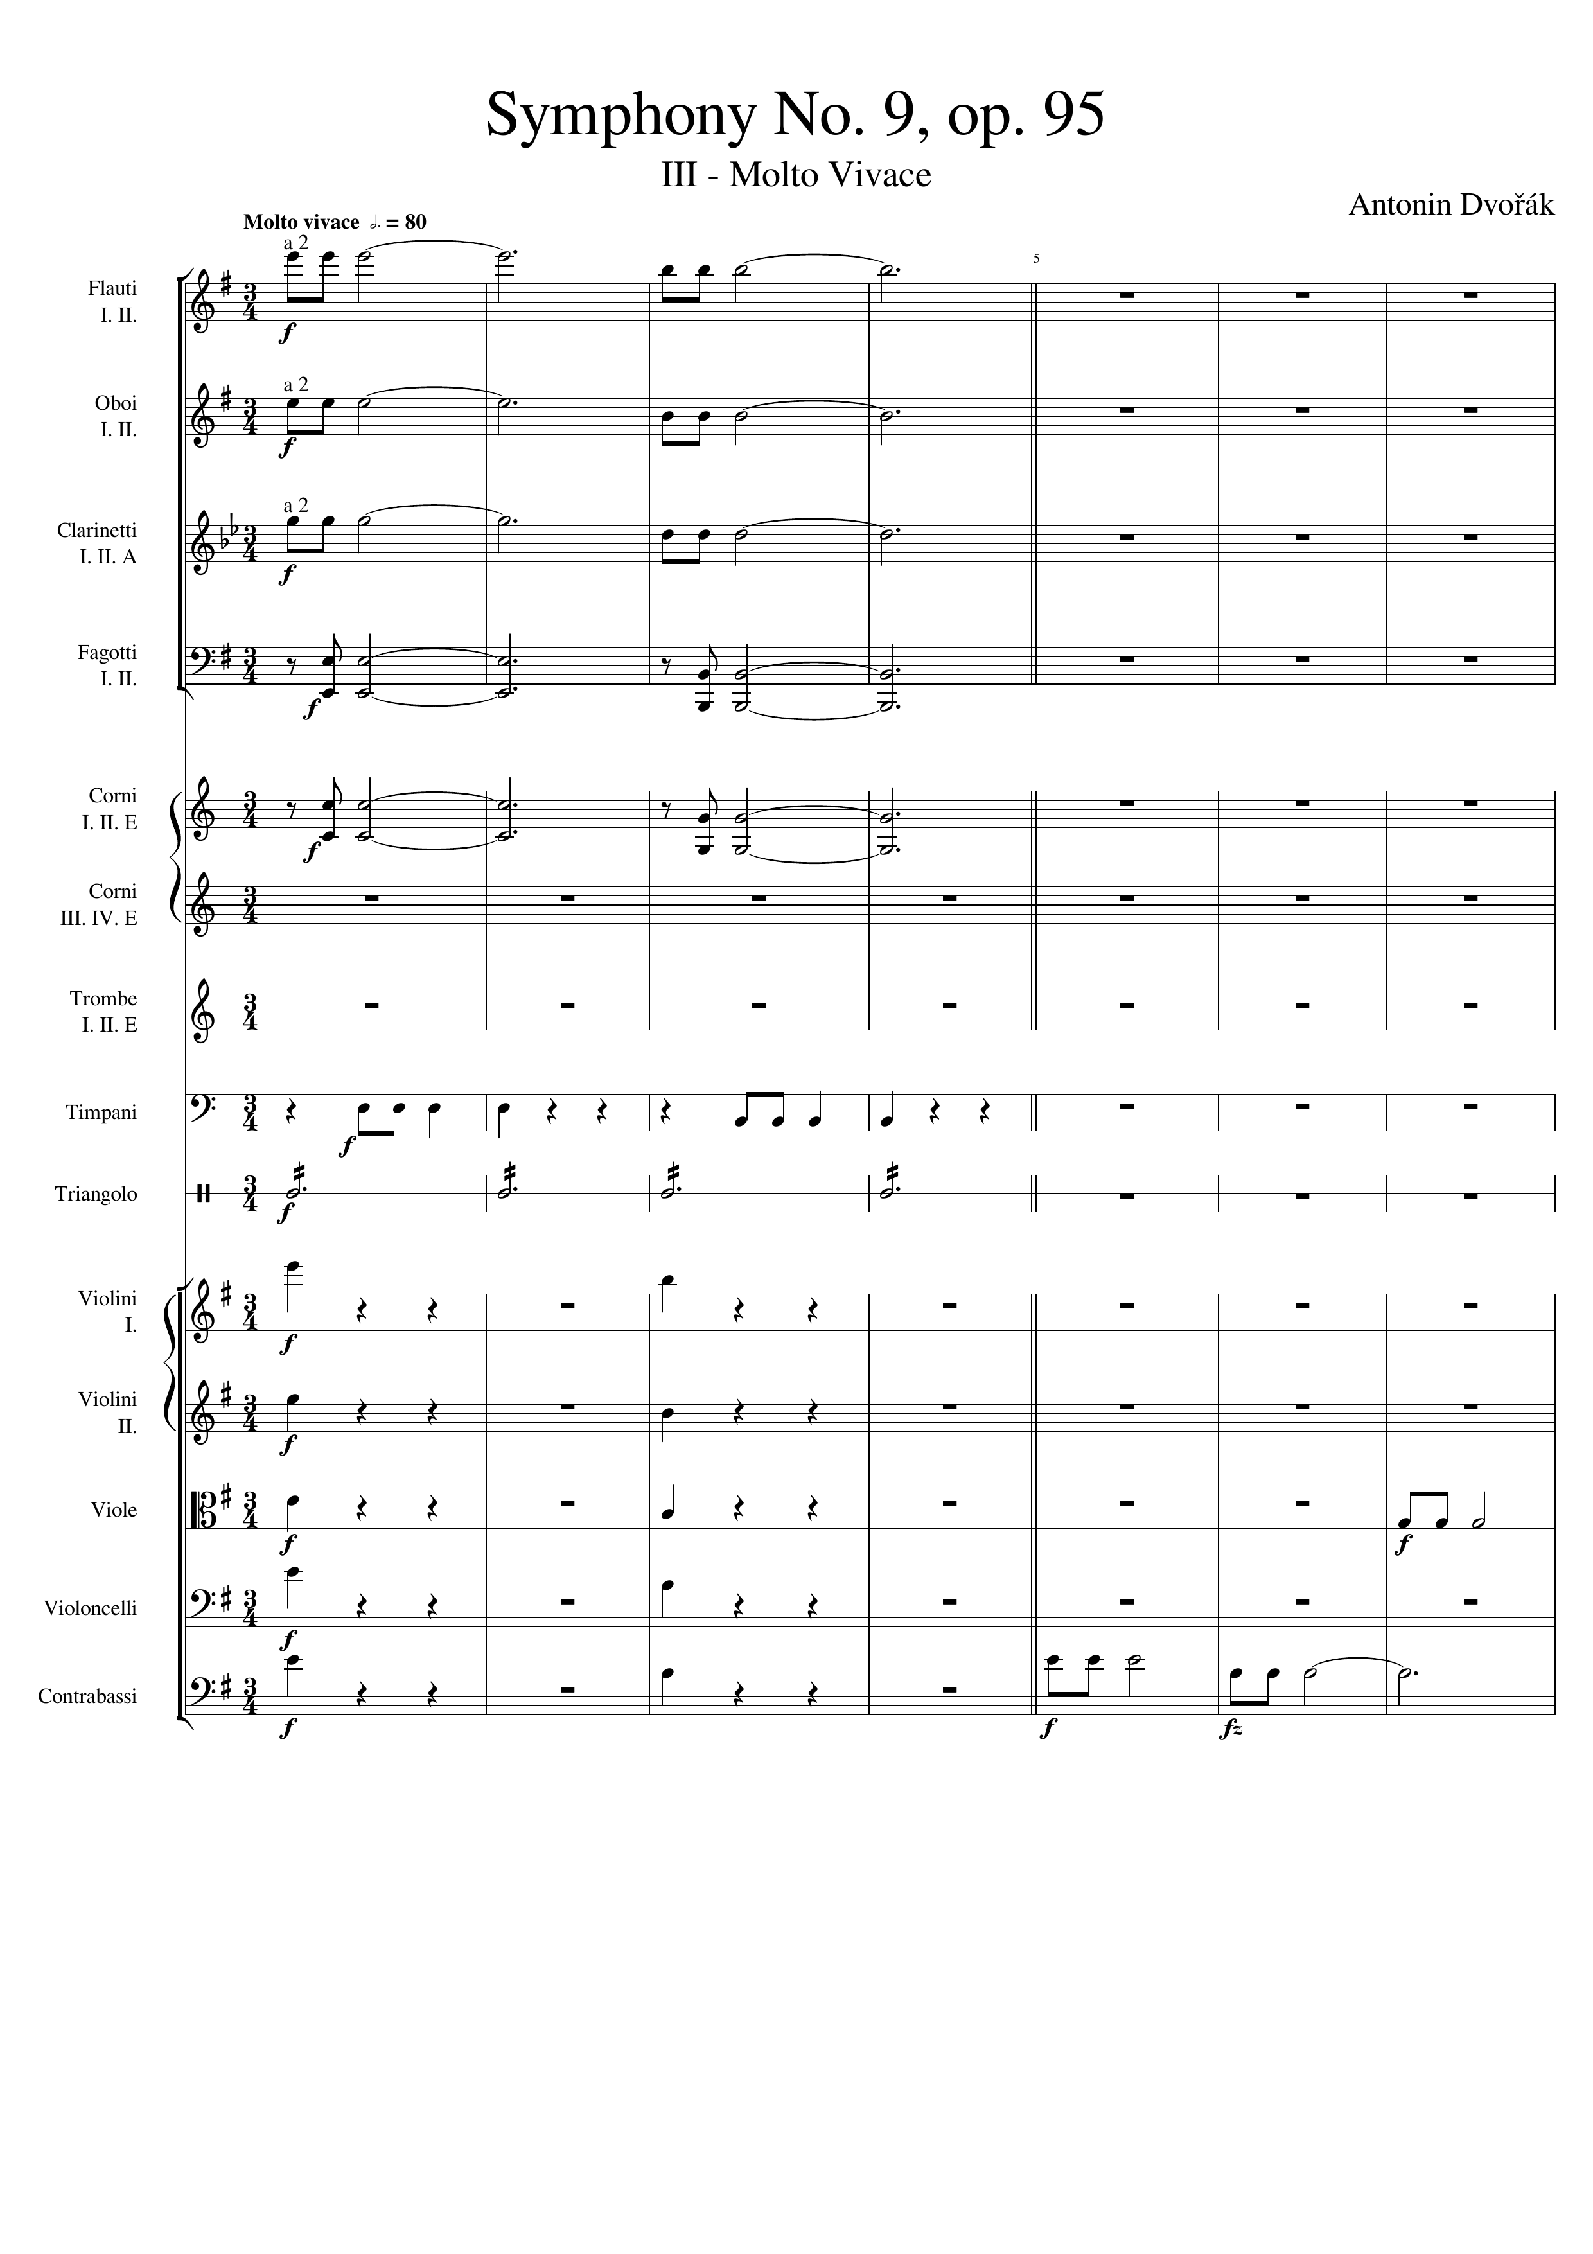
rhythm+harm
rhythm+harm
rhythm+harm
harm
harm
rhythm
rhythm
rhythm+harm
rhythm+harm
rhythm+harm
mel
rhythm+harm
rhythm+harm
mel

Slide 2
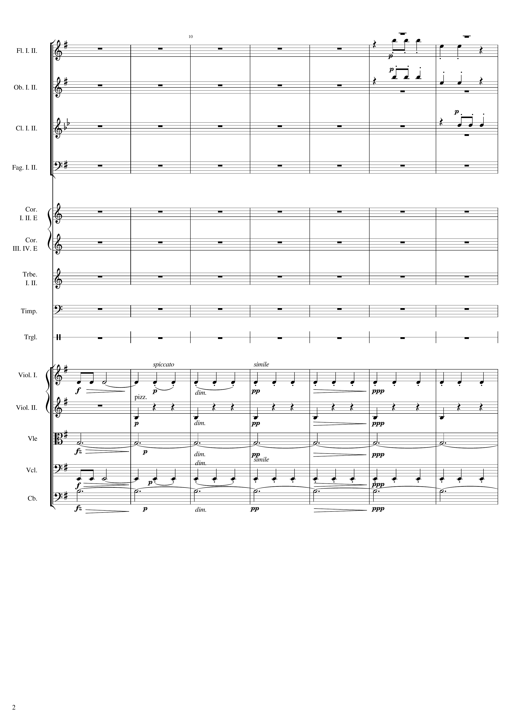
mel
mel
mel
mel
rhythm
rhythm
harm
mel
rhythm
harm

Slide 3
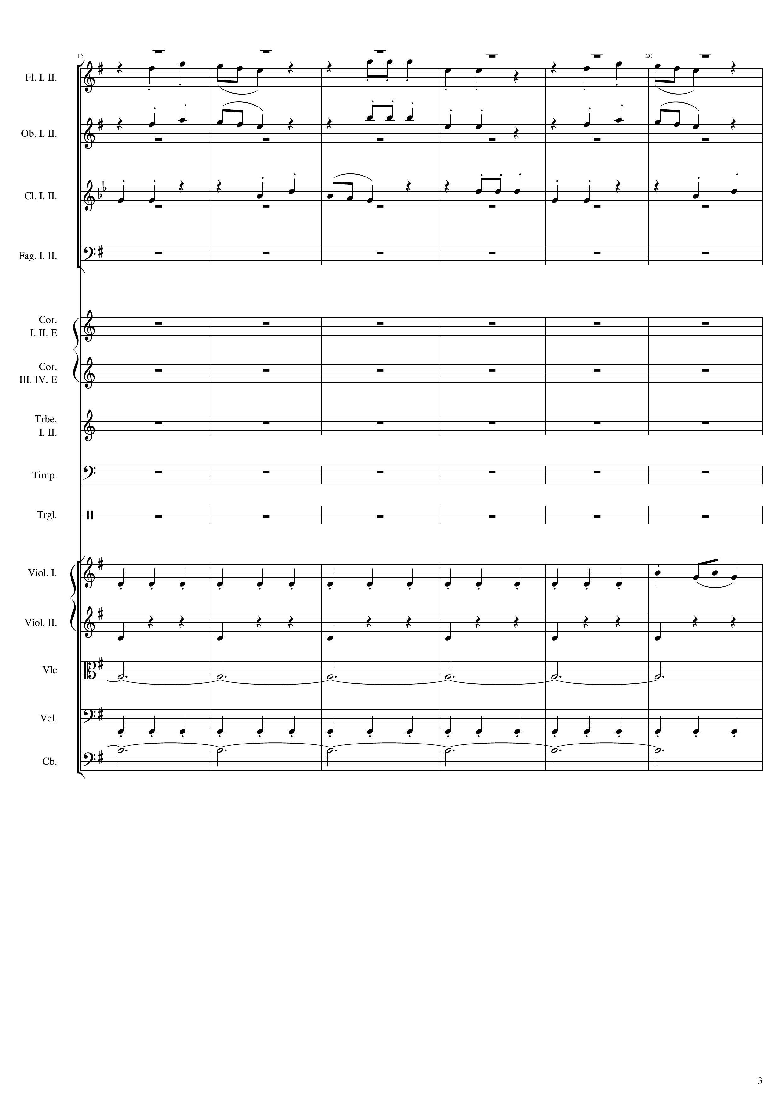
mel
mel
mel
rhythm
mel
rhythm
harm
rhythm
harm

Slide 4
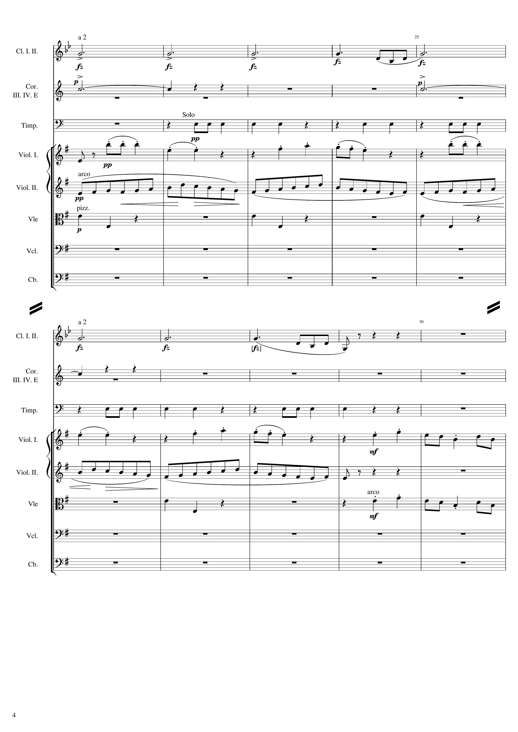
60
mel
harm
rhythm
mel
rhythm
rhythm
mel
85
harm
rhythm
mel
mel
rhythm
rhythm
mel

Slide 5
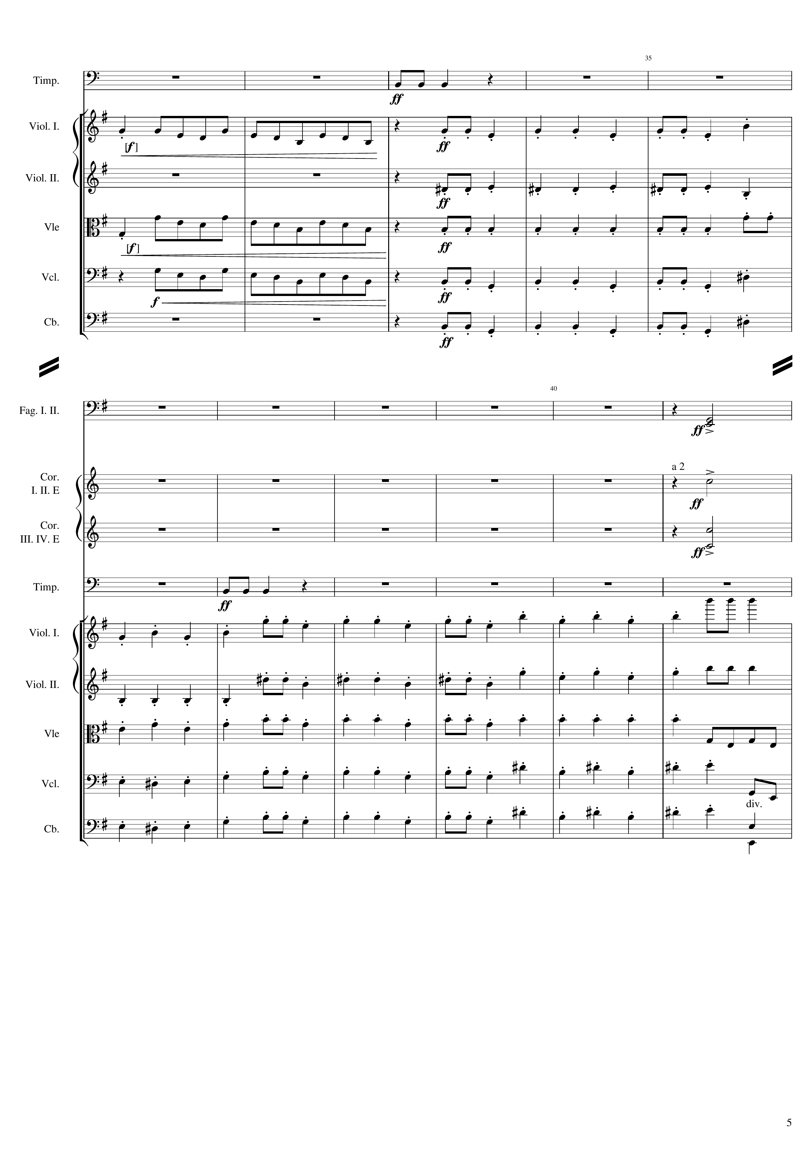
96
rhythm
mel
mel
mel
mel
mel
mel
mel
mel
121
rhythm+harm
mel
mel
rhythm
mel
mel
mel
mel
mel
rhythm
mel
rhythm
mel
rhythm

Slide 6
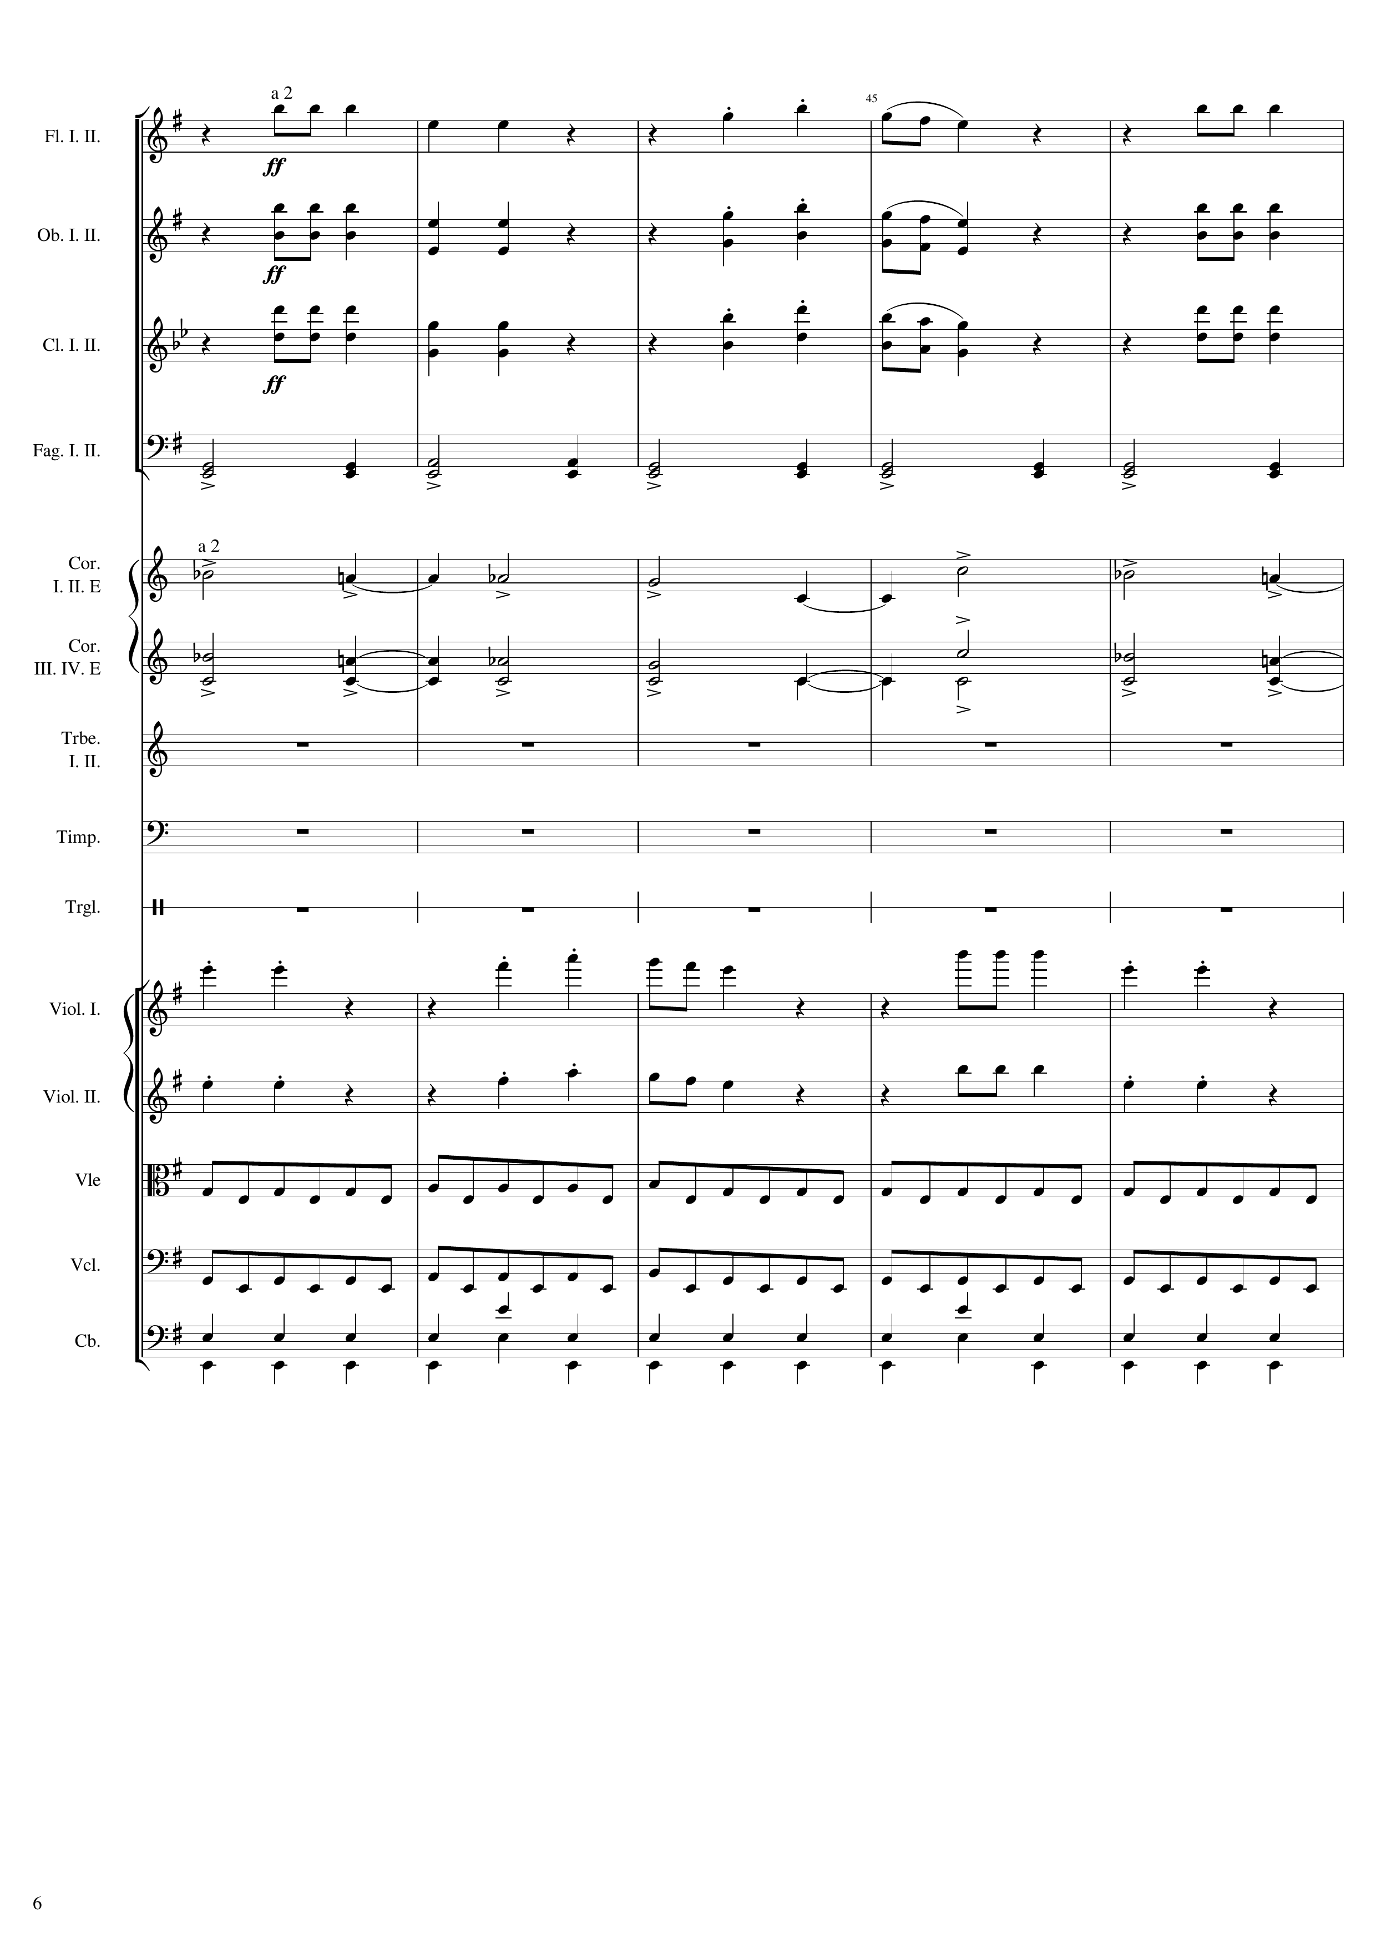
124
mel
mel
mel
rhythm+harm
mel
mel
mel
mel
rhythm
rhythm
rhythm

Slide 7
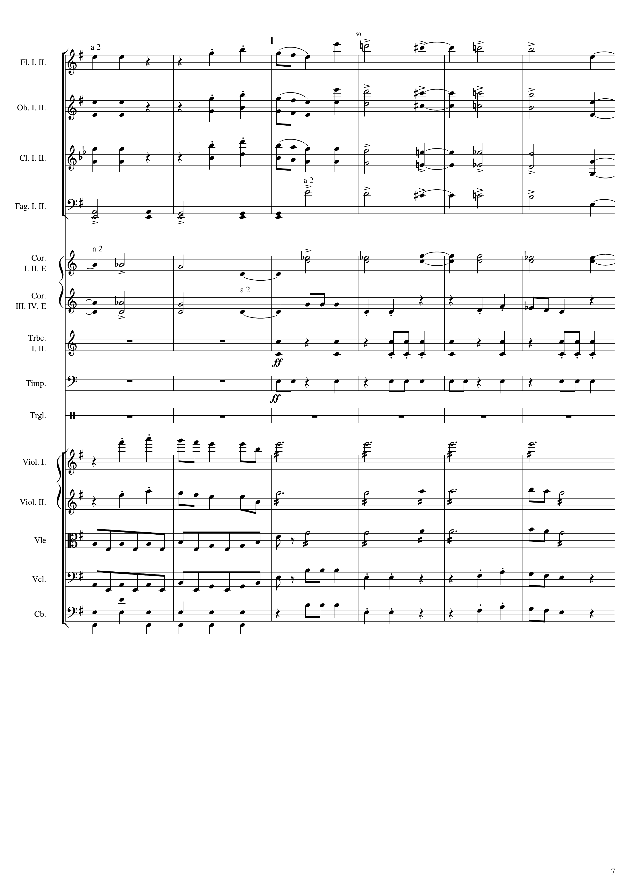
144
mel
mel
mel
mel
mel
mel
rhythm+harm
mel
mel
rhythm+harm
mel
mel
rhythm
rhythm
mel
harm
mel
harm
mel
rhythm
harm
mel
rhythm
mel
rhythm
mel

Slide 8
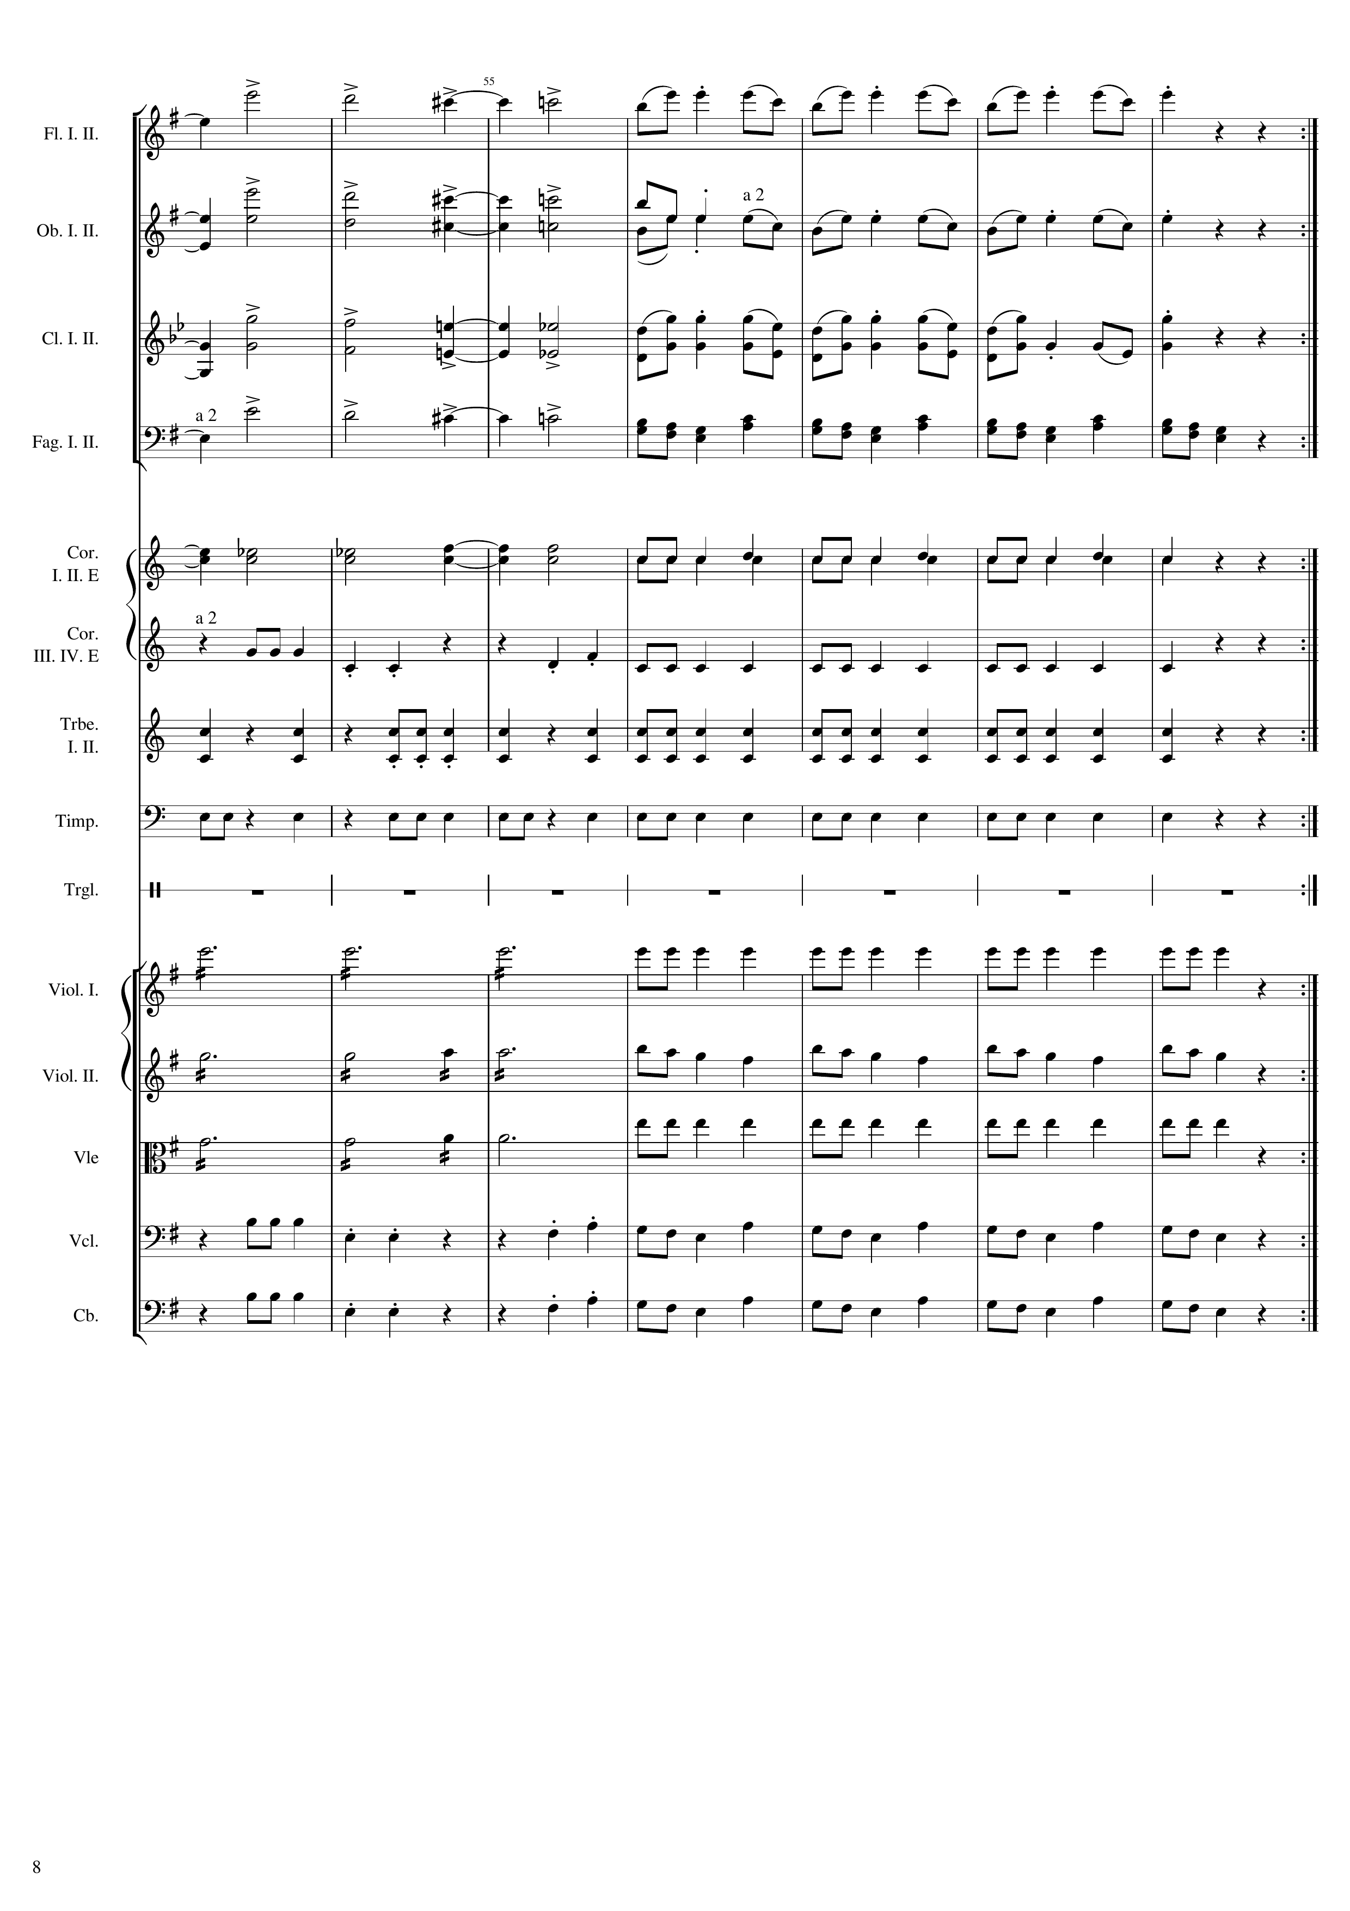
mel
177
mel
mel
mel
rhythm+harm
rhythm
mel
rhythm
rhythm
rhythm
harm
rhythm
harm
mel
harm
rhythm
mel
mel

Slide 9
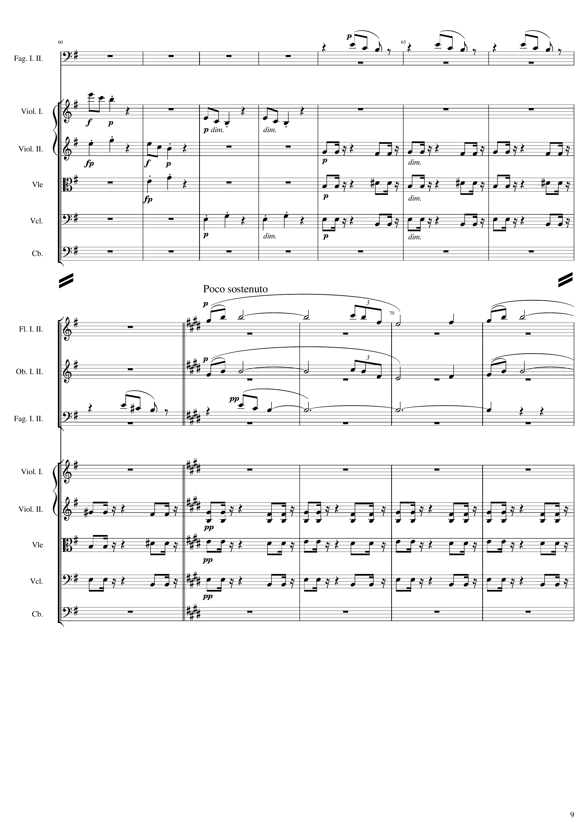
119 th bar
mel
mel
mel
rhythm
mel
rhythm
rhythm
rhythm
rhythm
rhythm
127th bar
mel
mel
mel
mel+harm
rhythm
rhythm+harm
rhythm
rhythm+harm
rhythm
rhythm+harm

Slide 10
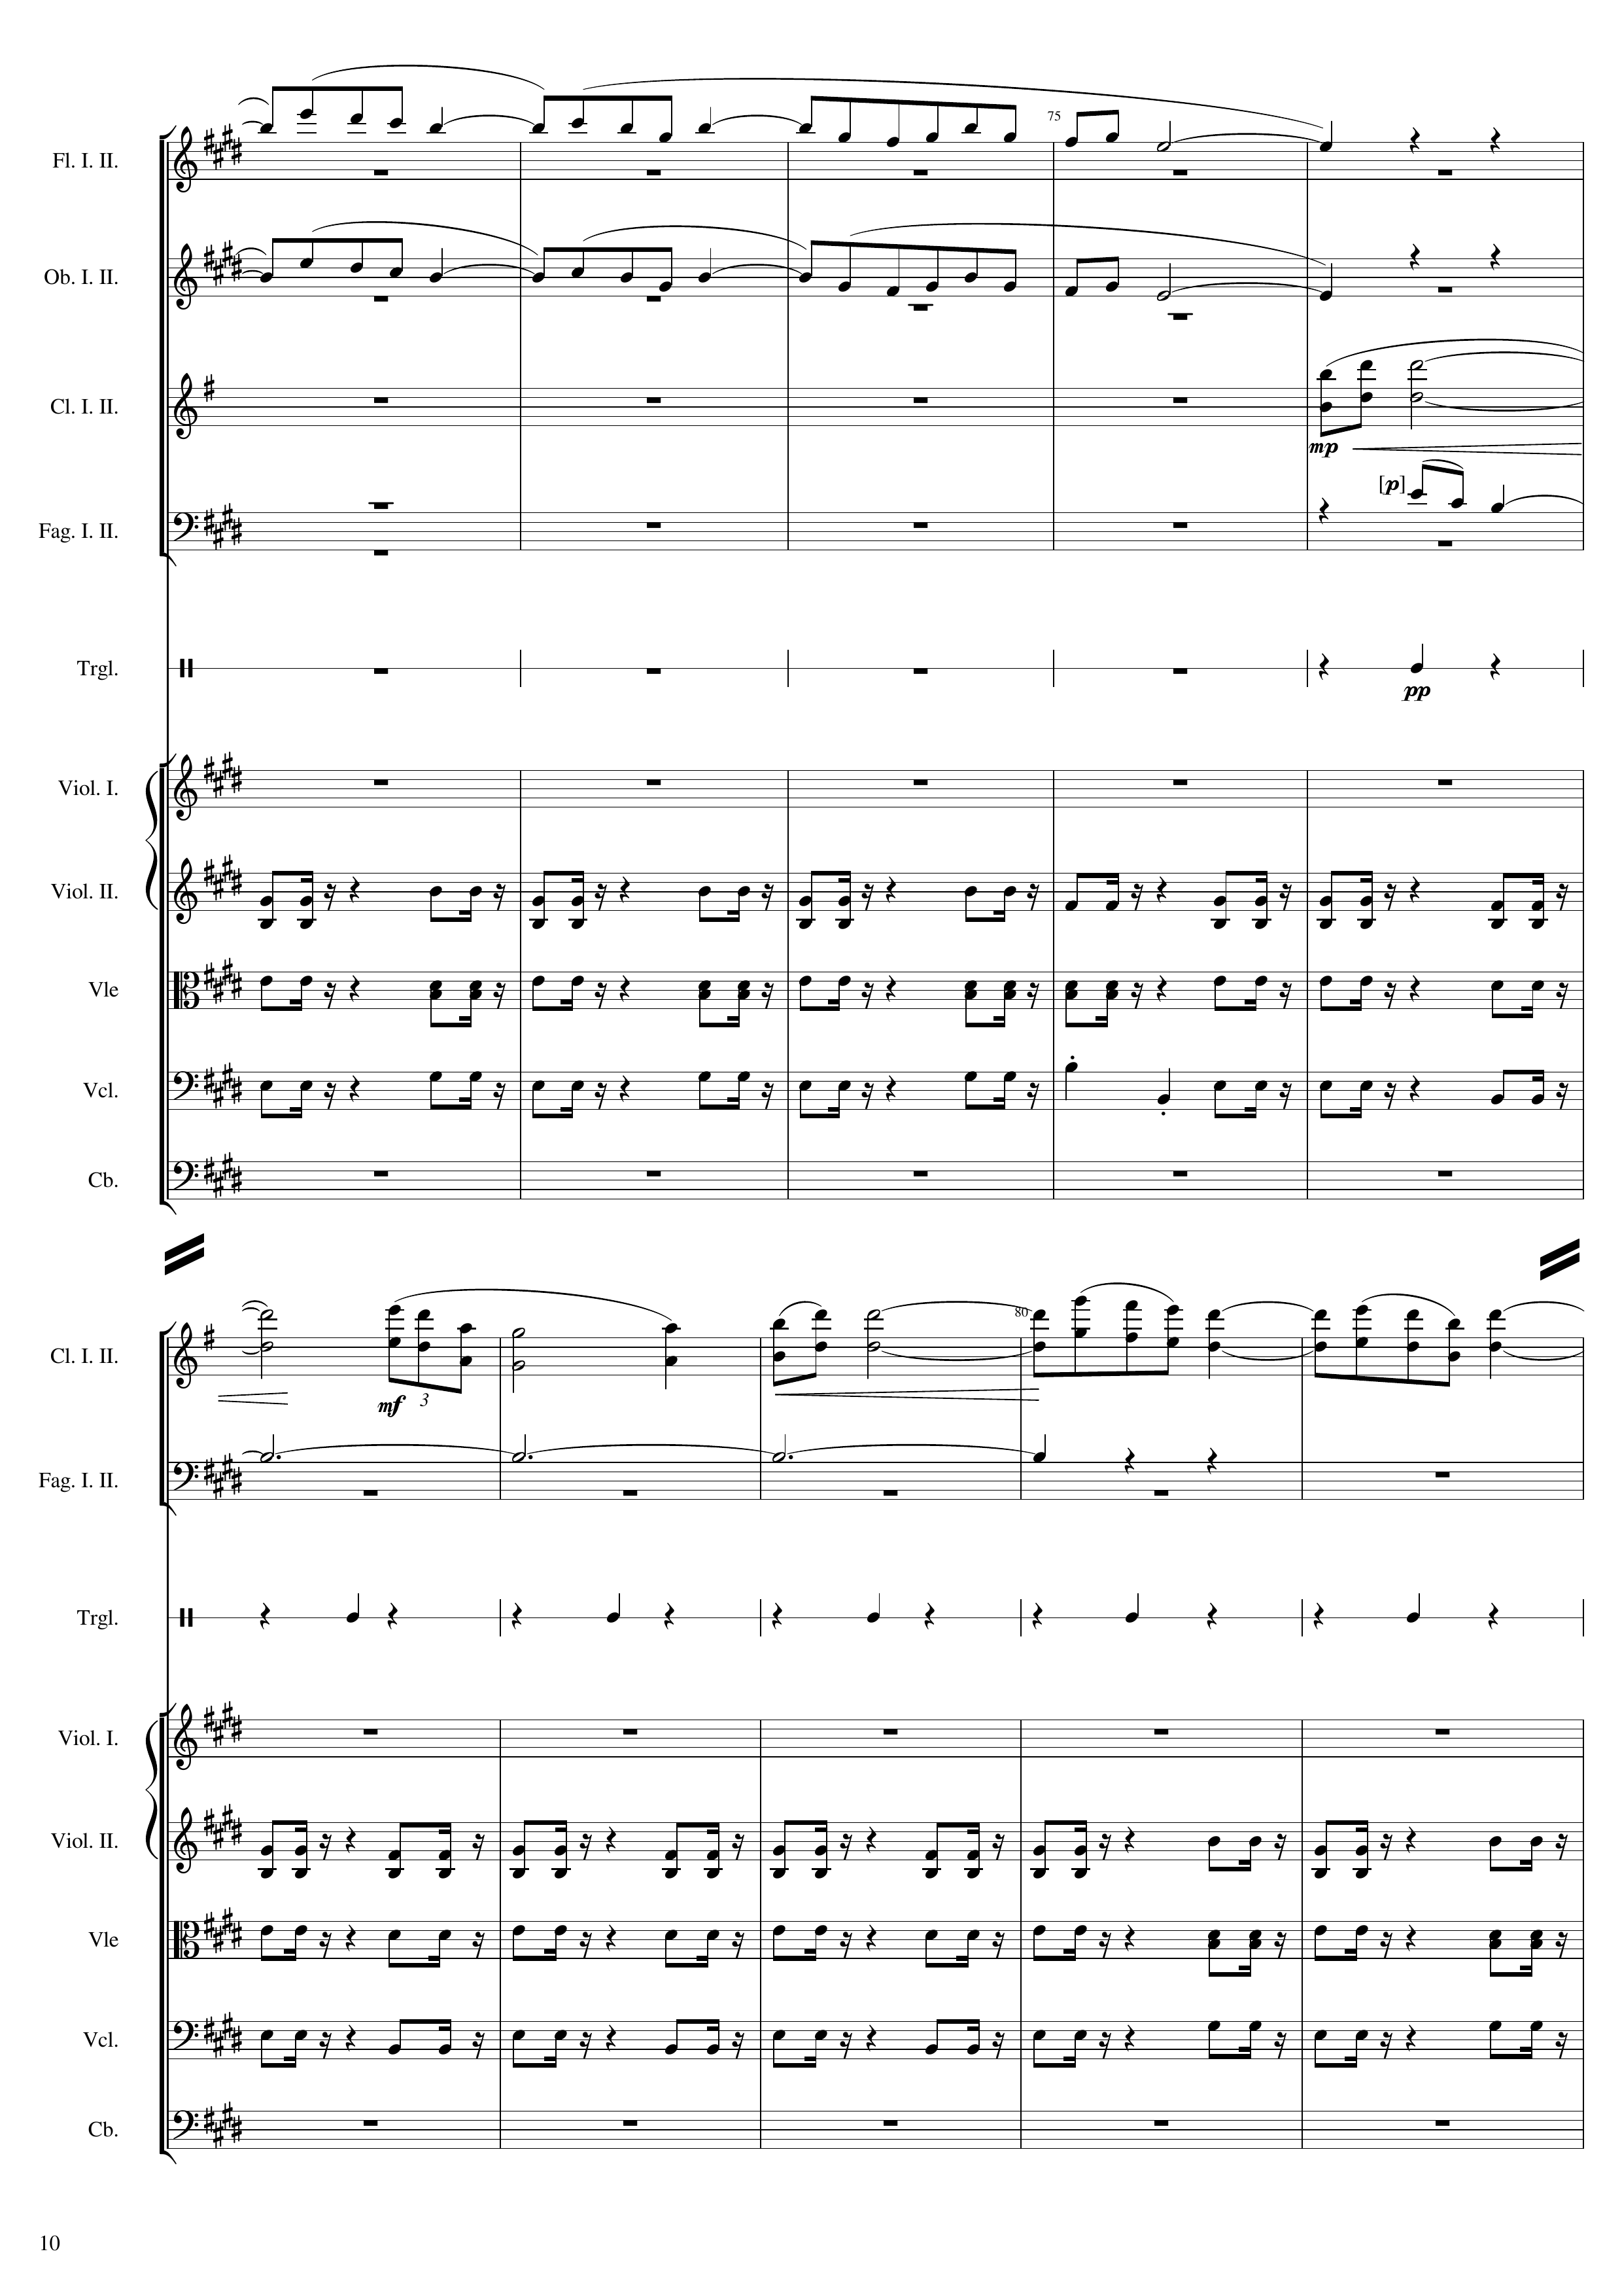
402
135 th bar
mel
mel
mel
mel+harm
rhythm
rhythm+harm
rhythm+harm
rhythm+harm
mel
mel+harm
rhythm
rhythm+harm
rhythm+harm
rhythm+harm

Slide 11
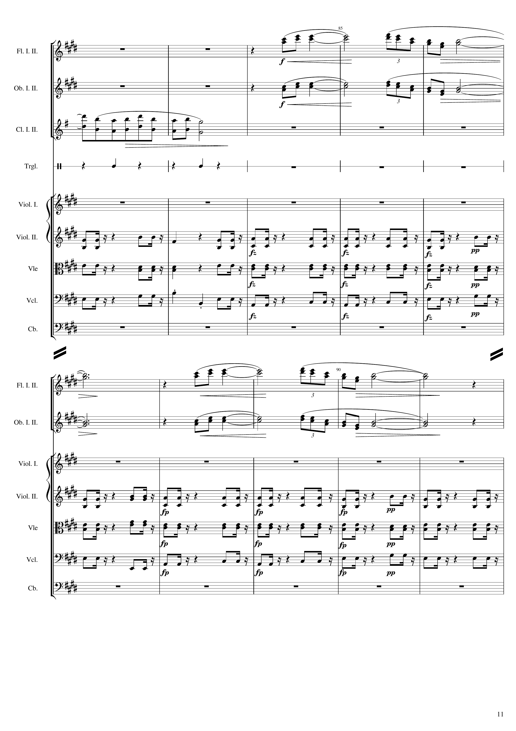
143 th bar
mel
mel
mel
rhythm
rhythm+harm
rhythm+harm
rhythm+harm
150 th bar
mel
mel
rhythm+harm
rhythm+harm
rhythm+harm

Slide 12
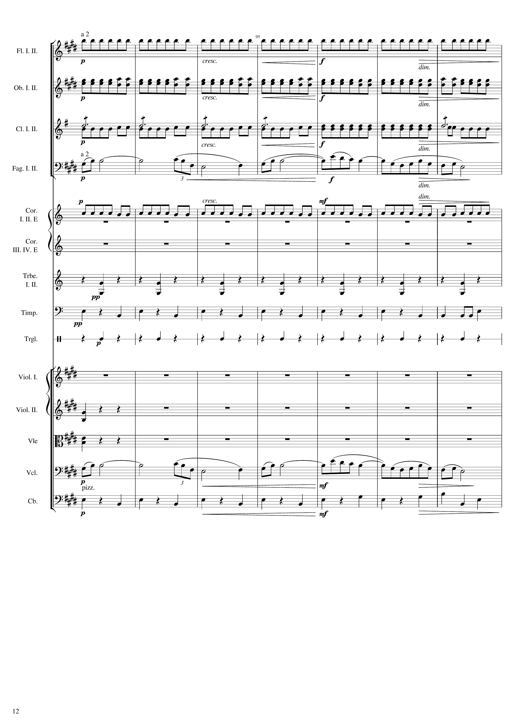
450
rhythm
rhythm
rhythm
mel
rhythm
rhythm
rhythm
rhythm
rhythm+harm
rhythm+harm
mel
rhythm

Slide 13
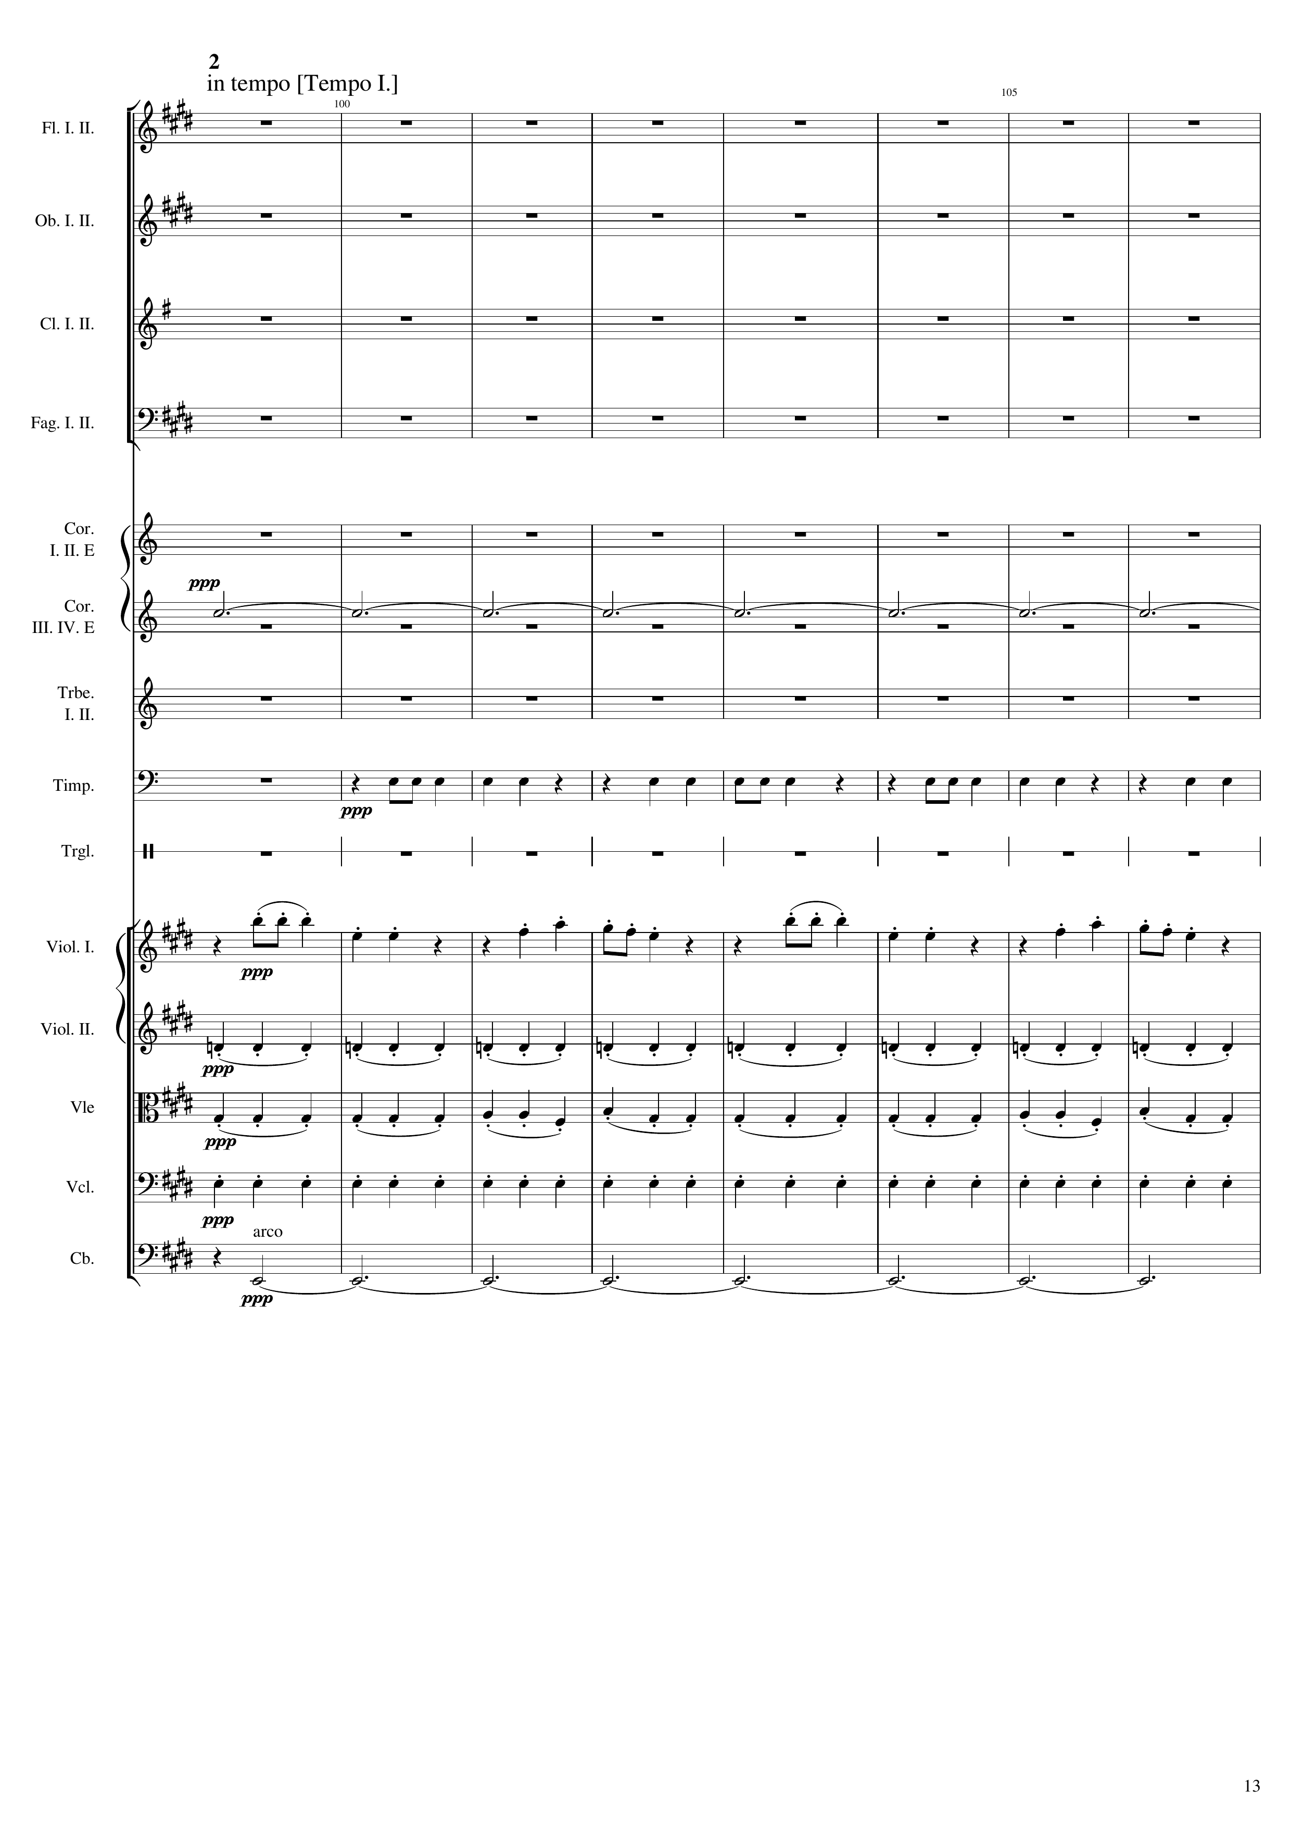
471
158 th bar
harm
rhythm
mel
rhythm
rhythm
rhythm
harm

Slide 14
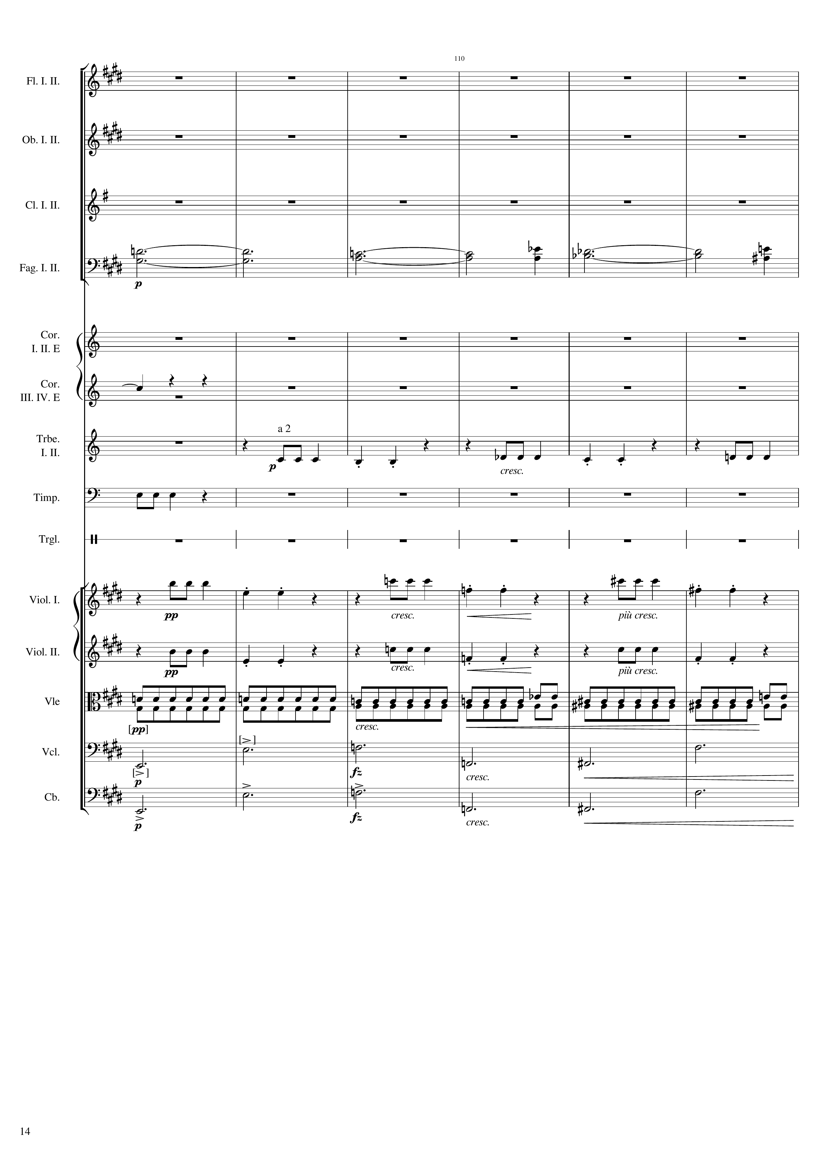
166th bar
harm
harm
mel
rhythm
mel
mel
rhythm
harm
harm

Slide 15
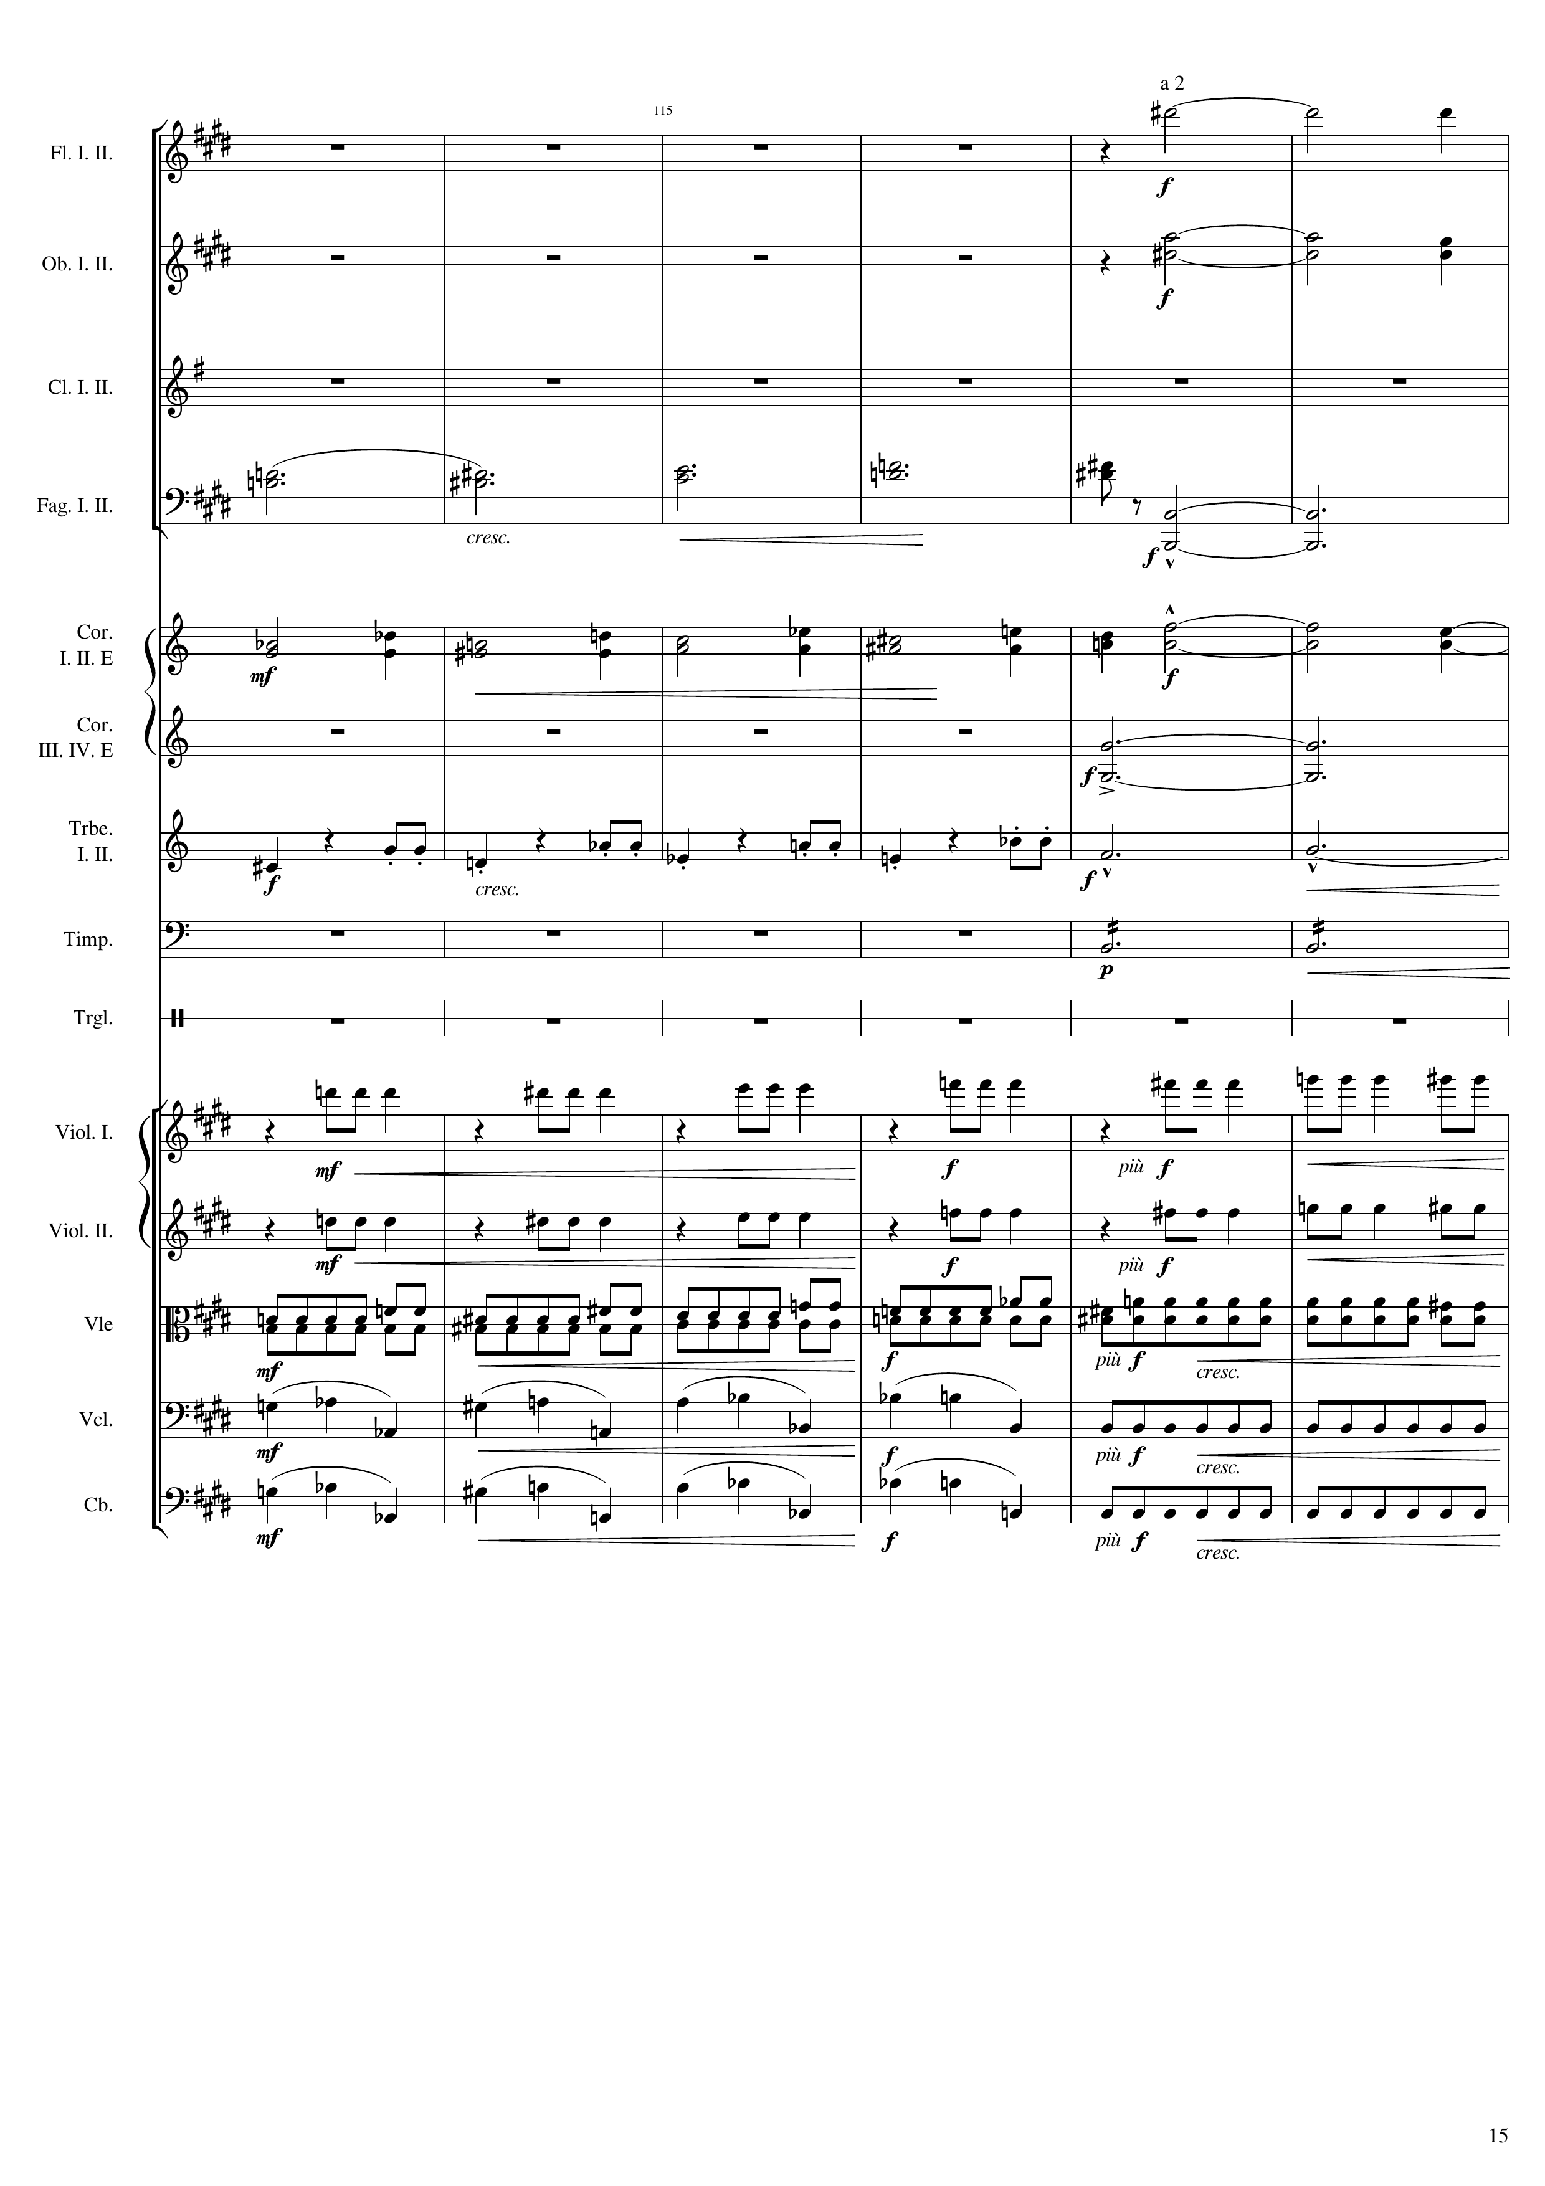
176th bar
513
harm
harm
harm
rhythm+harm
harm
harm
rhythm
harm
rhythm
mel
mel
rhythm
rhythm
rhythm

Slide 16
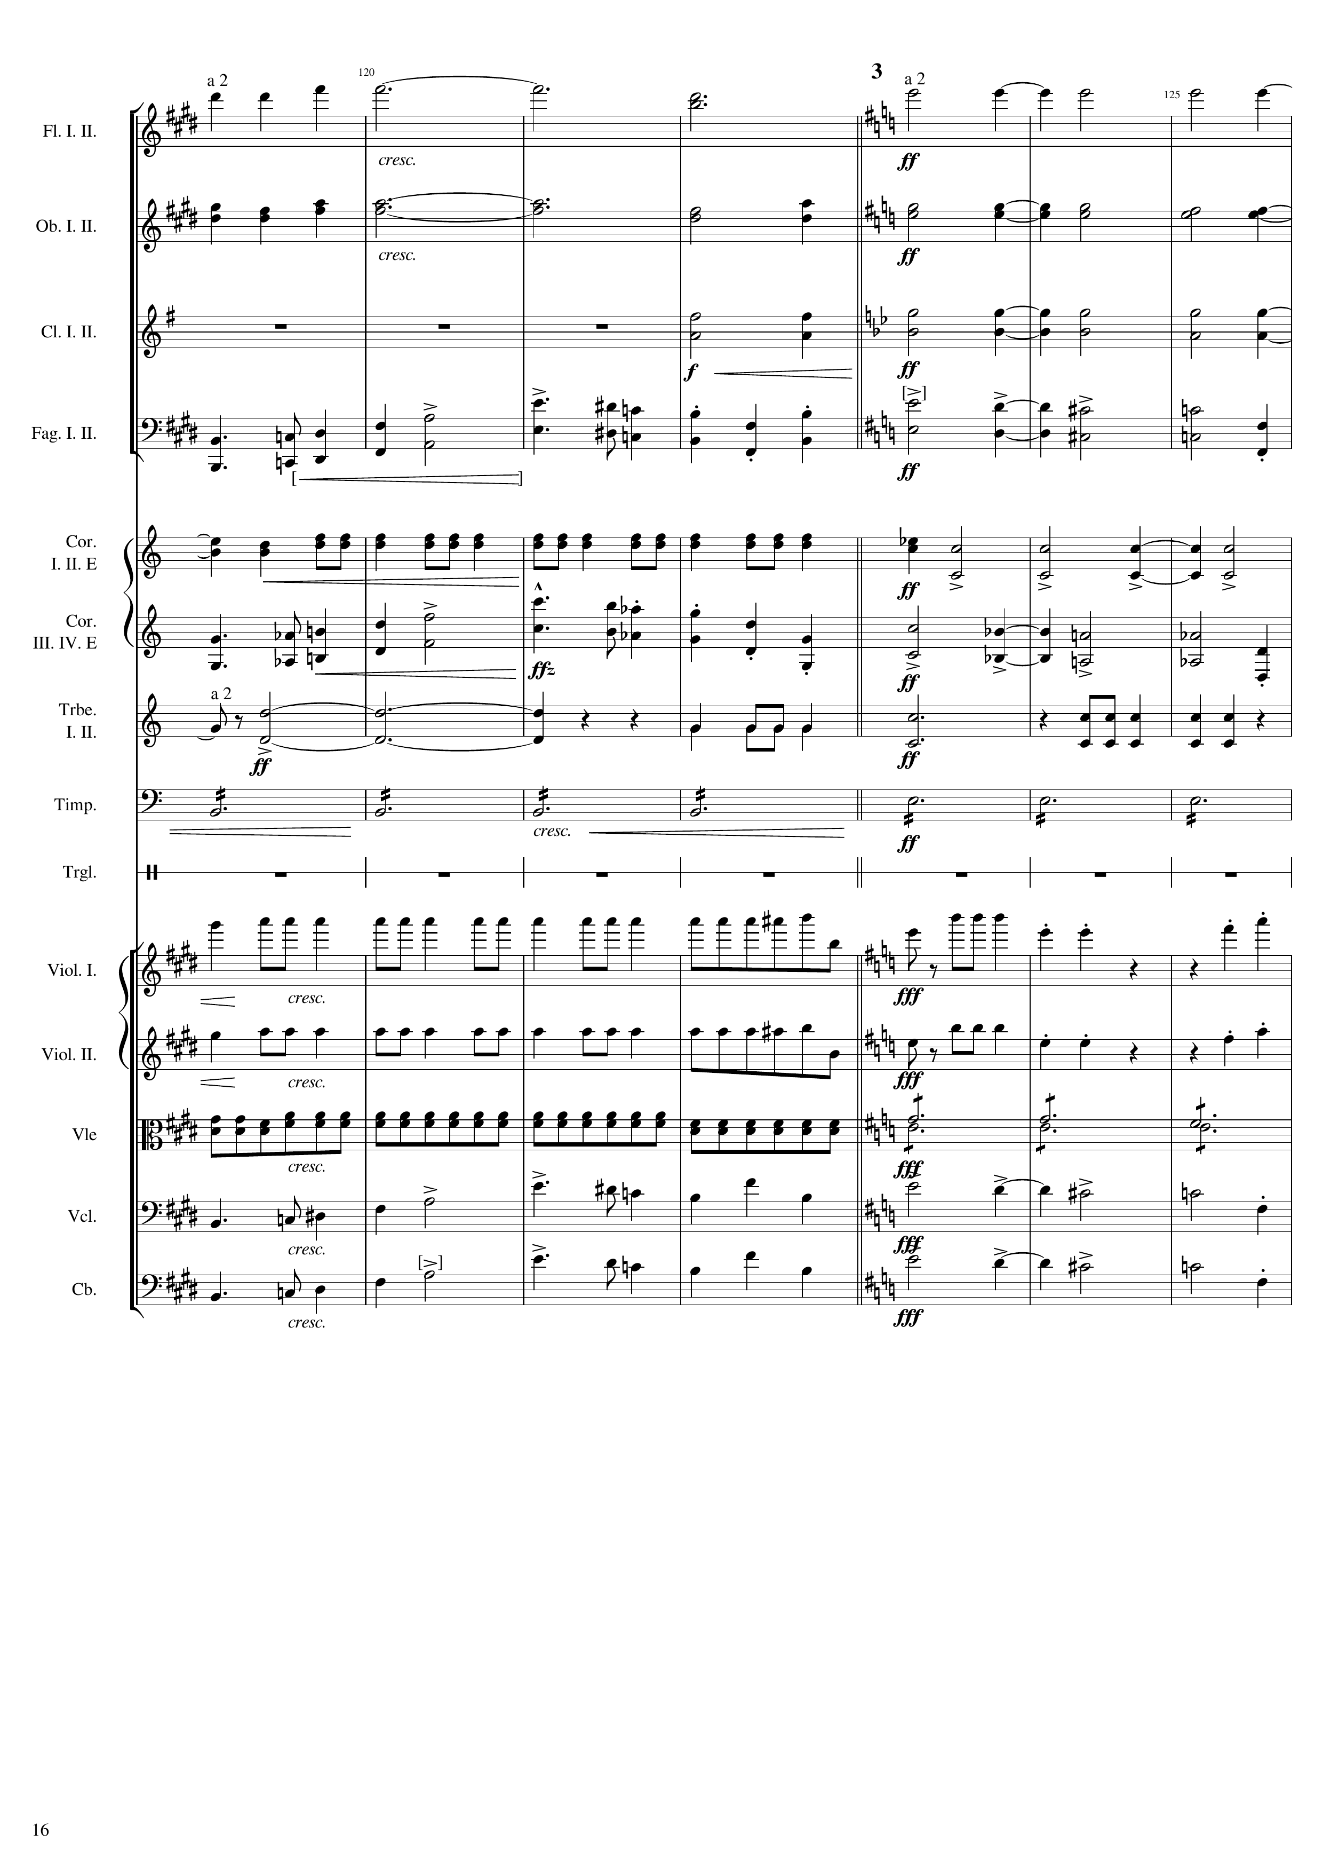
531
543
182th bar
harm
rhythm+harm
harm
rhythm+harm
rhythm+harm
rhythm+harm
mel
mel
rhythm
rhythm
mel
mel
rhythm
rhythm
rhythm
rhythm
mel
mel
mel
mel
rhythm
harm
mel
mel
mel
mel

Slide 17
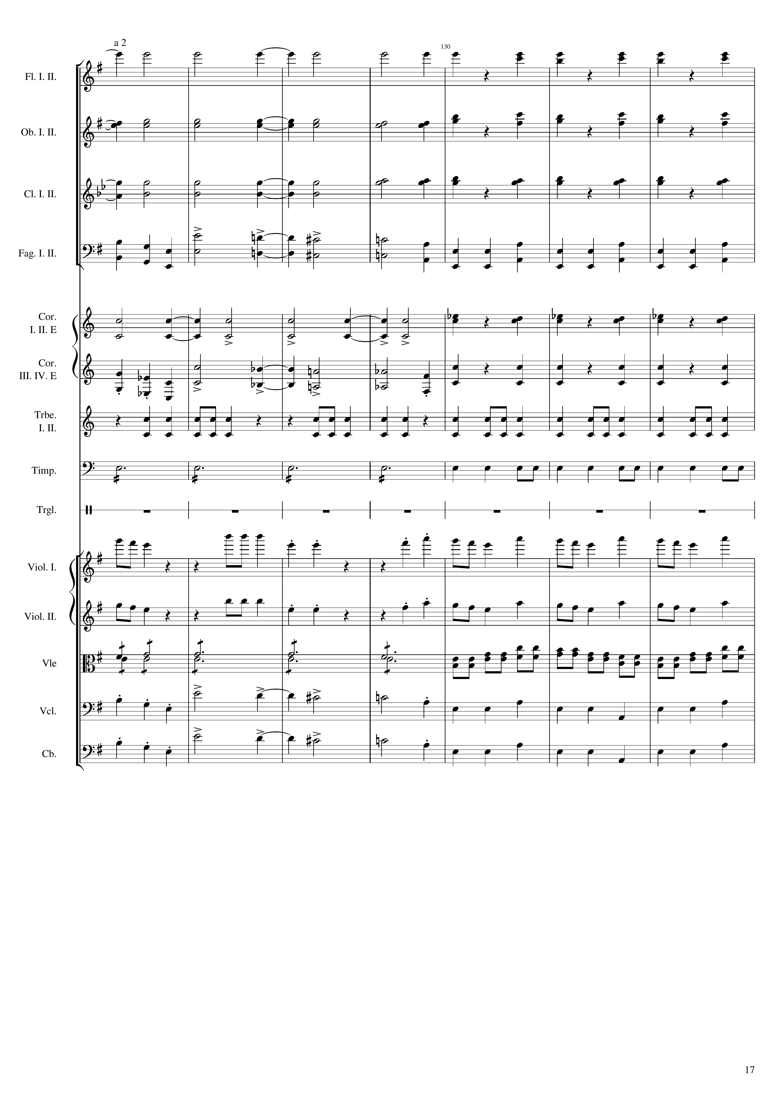
564
rhythm+harm
rhythm+harm
rhythm+harm
rhythm+harm
rhythm+harm
rhythm+harm
mel
rhythm
rhythm
rhythm+harm
mel
rhythm
rhythm
rhythm
harm
rhythm
mel
mel
harm
rhythm+harm
mel
rhythm
mel
rhythm

Slide 18
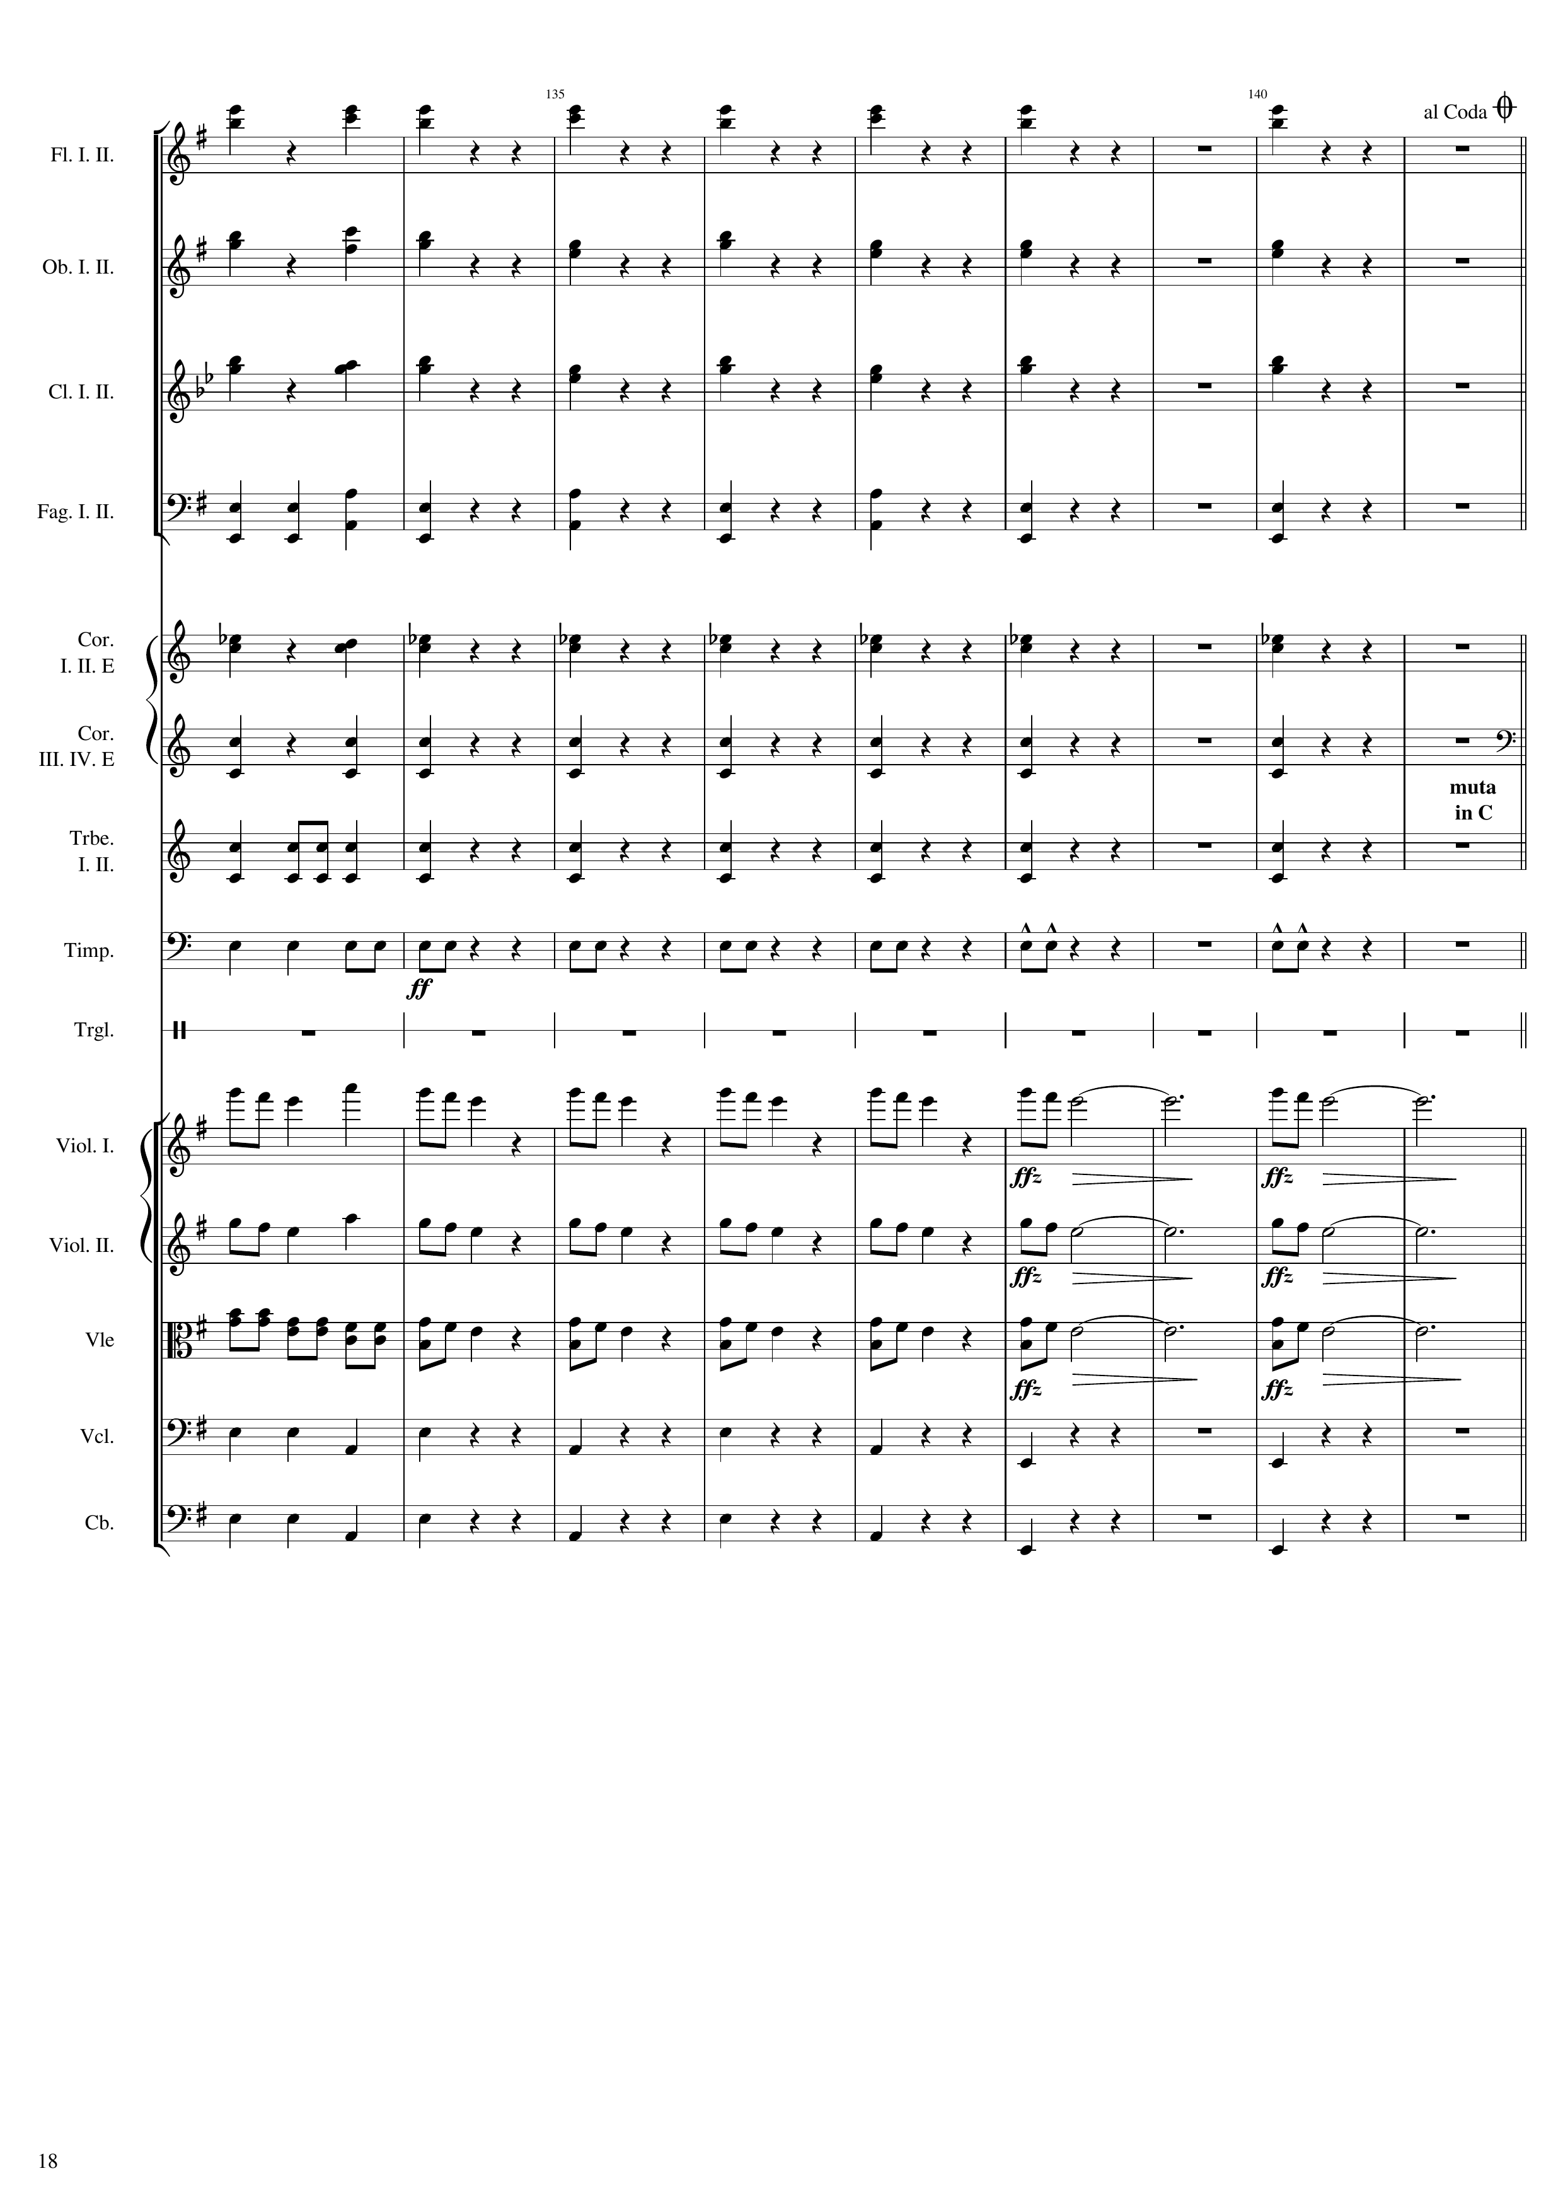
576
600
rhythm+harm
rhythm+harm
rhythm+harm
rhythm+harm
rhythm+harm
rhythm+harm
rhythm
rhythm
rhythm+harm
rhythm+harm
rhythm
rhythm
rhythm
rhythm
rhythm
rhythm
mel
mel
mel
mel
rhythm+harm
mel
rhythm
rhythm
rhythm
rhythm

Slide 19
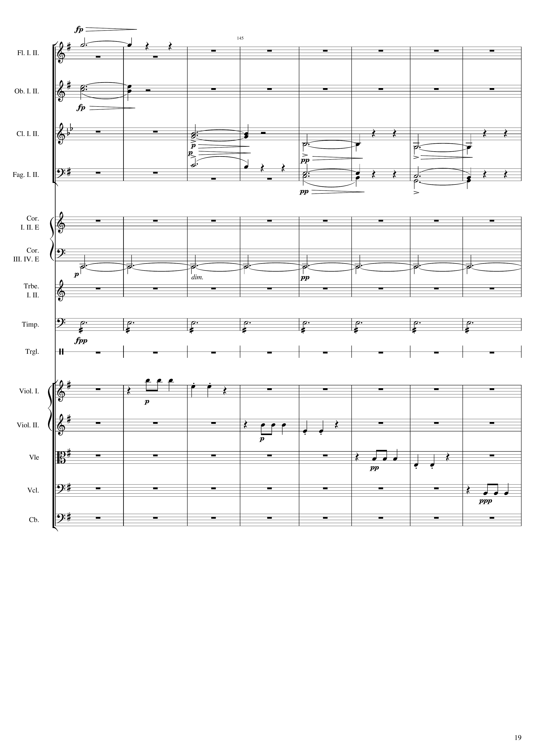
600
harm
204th bar
mel
harm
harm
mel
mel
harm
rhythm
mel
mel
mel
mel

Slide 20
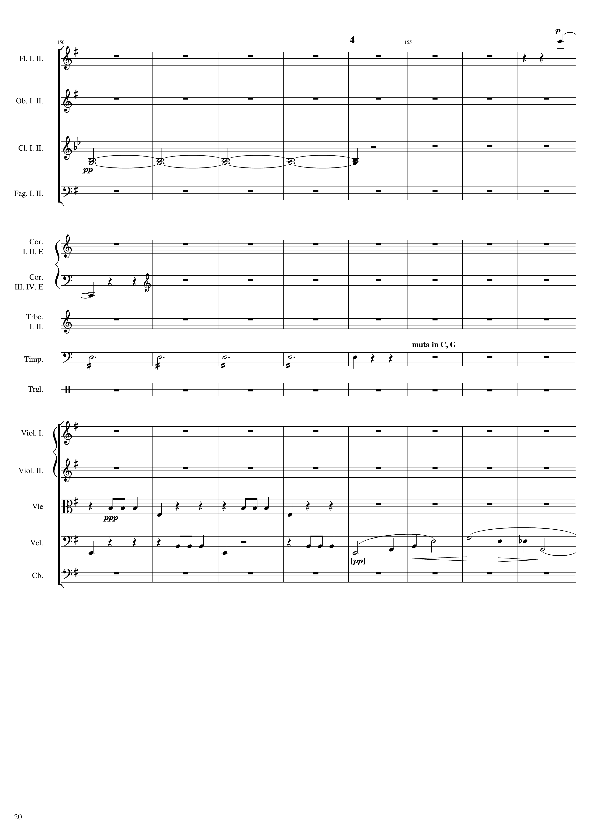
636
mel
harm
harm
rhythm
mel
mel
mel+harm

Slide 21
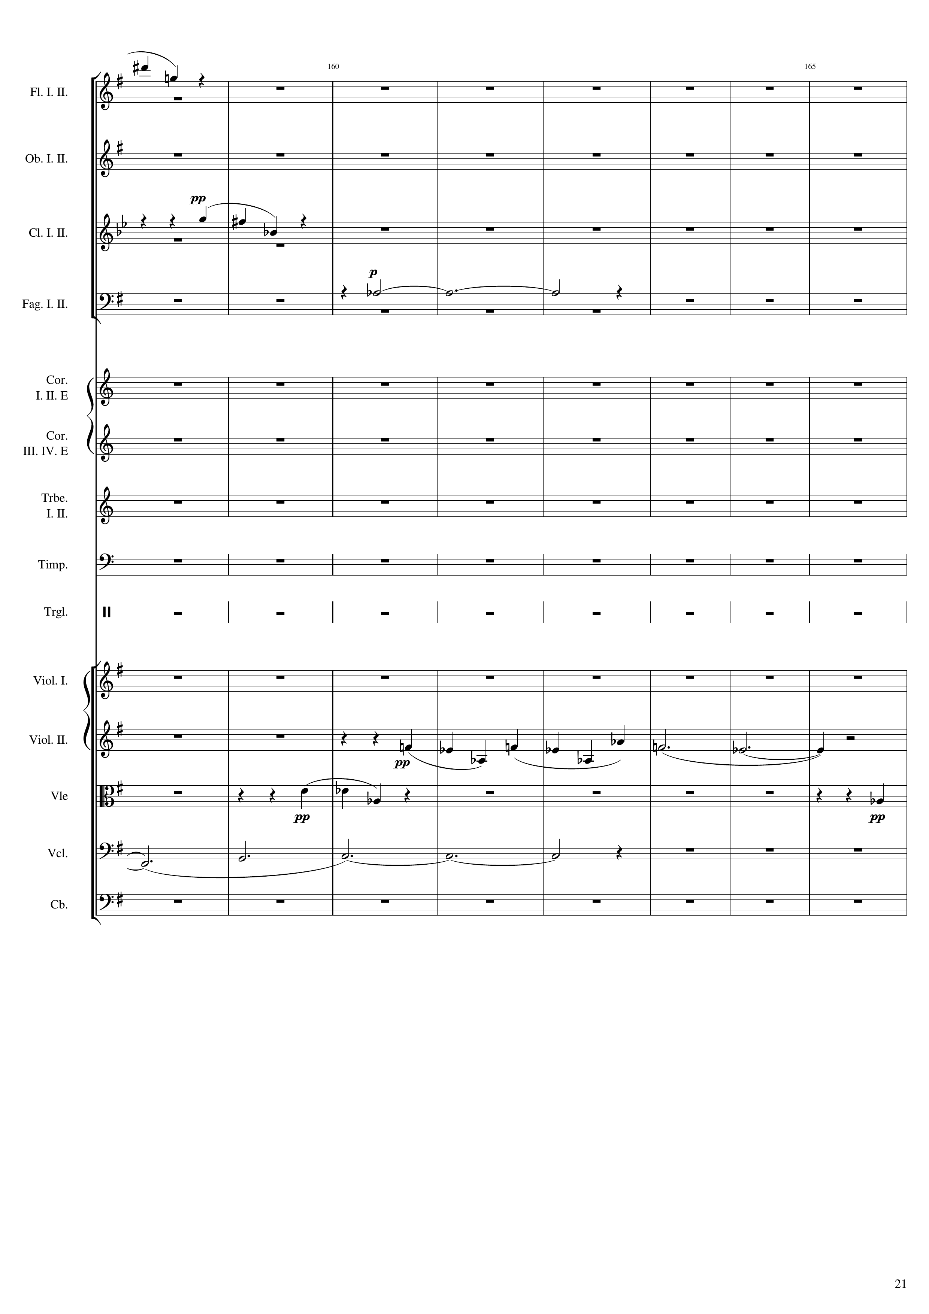
648
660
mel
mel
harm
mel
mel
mel
mel+harm

Slide 22
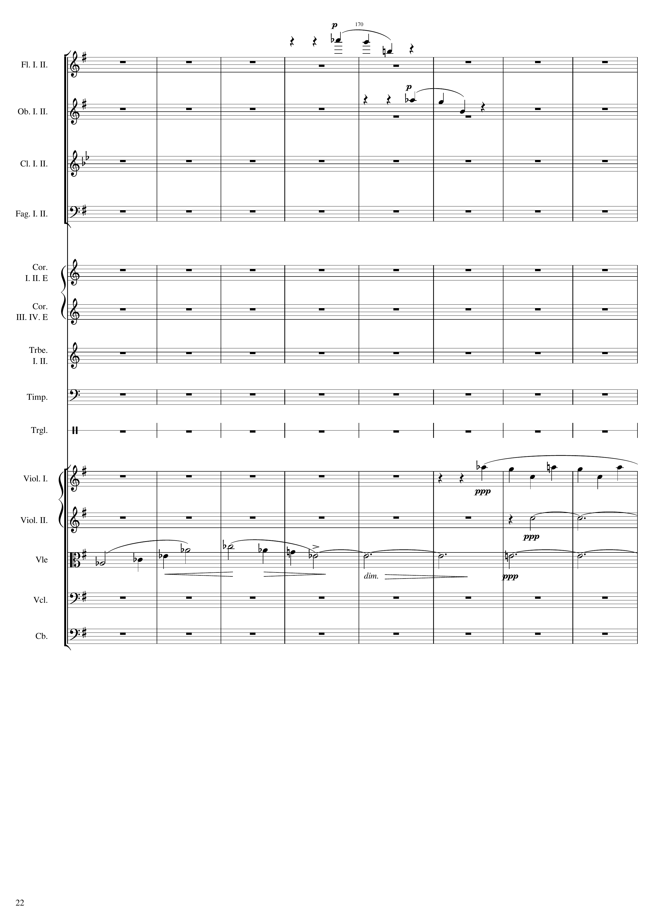
mel
690
mel
mel+rhythm
harm
mel
harm

Slide 23
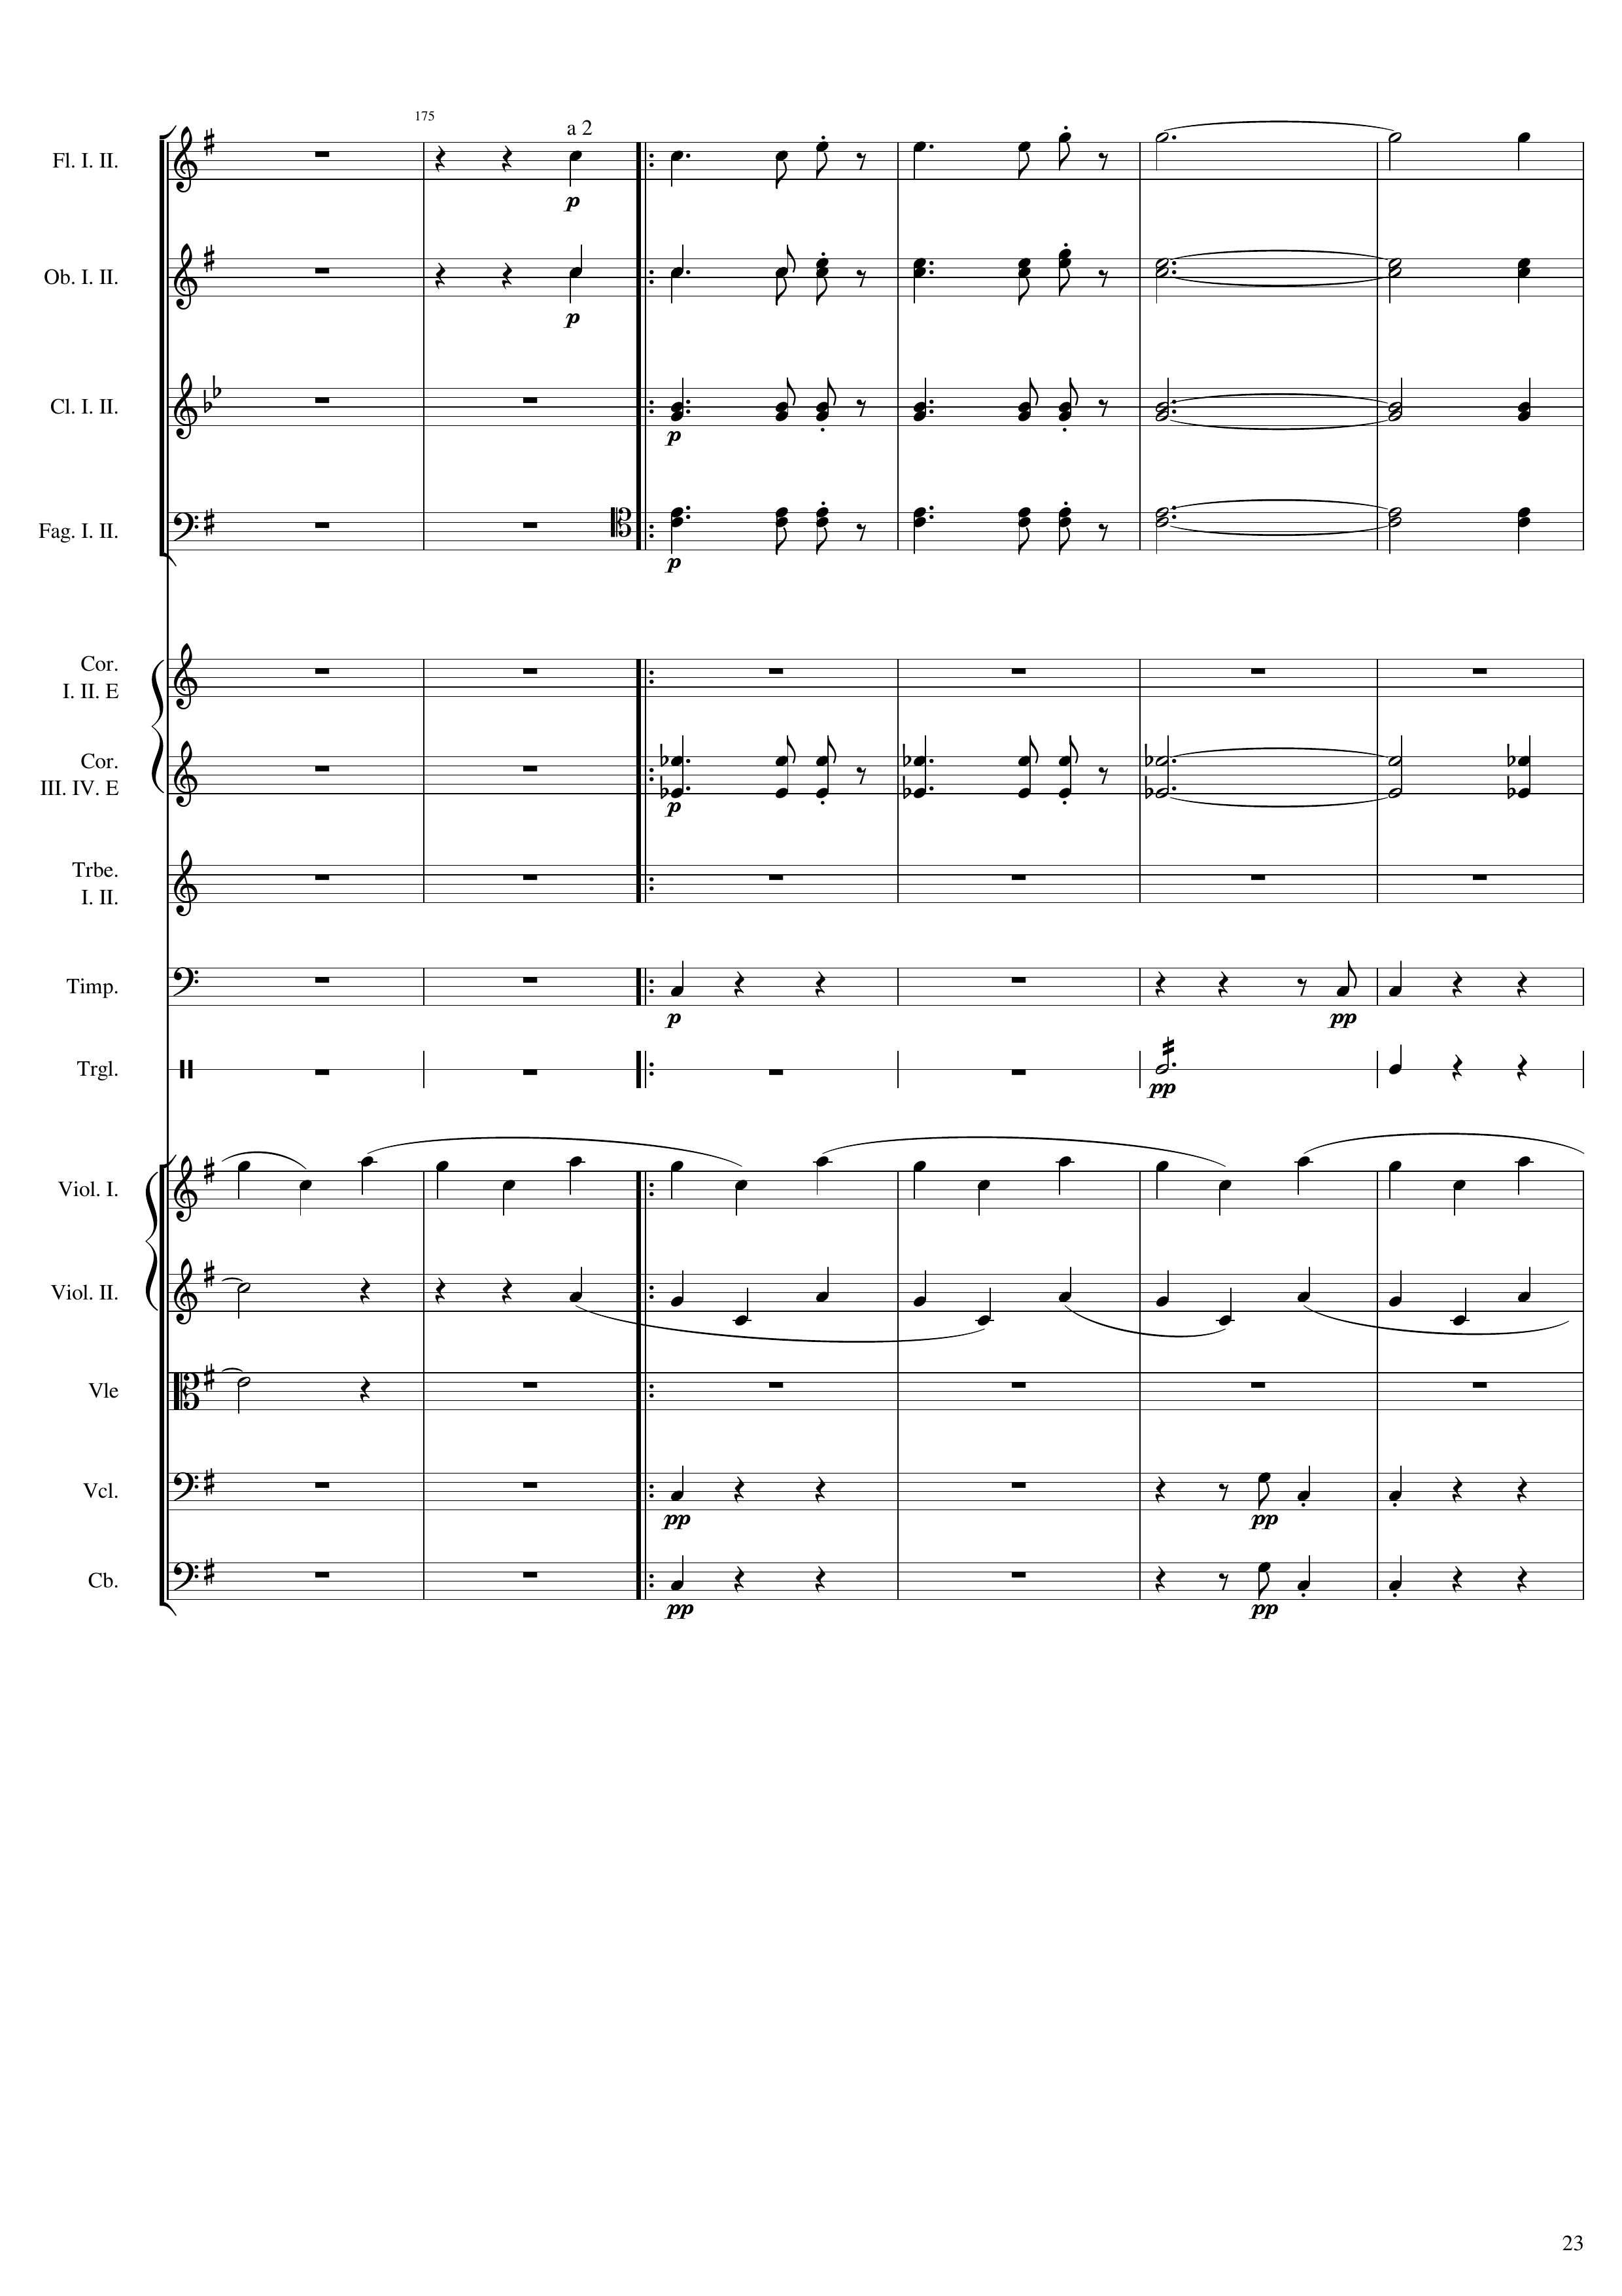
702
mel
mel
rhythm+harm
rhythm+harm
rhythm+harm
rhythm
rhythm
mel+rhythm
harm
mel+rhythm
harm
rhythm
rhythm

Slide 24
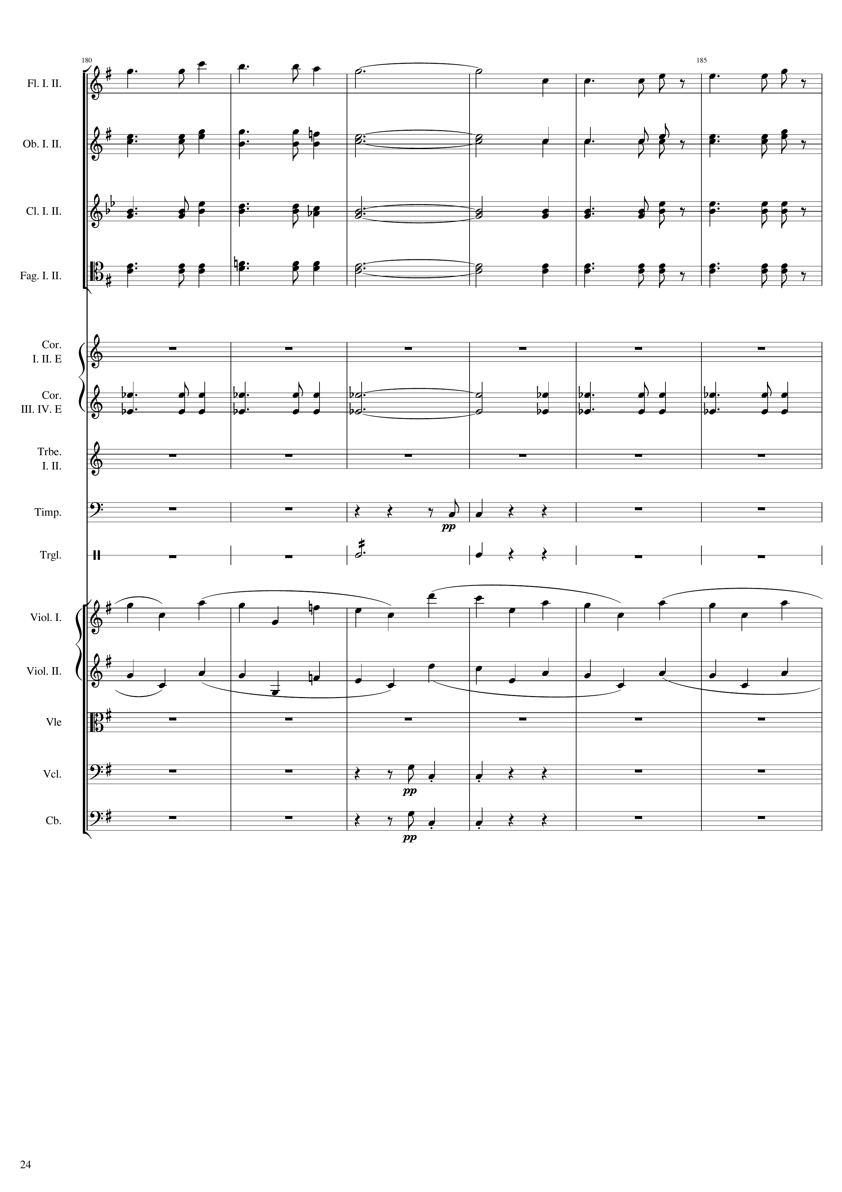
716
mel
mel
mel
mel
mel
mel
rhythm+harm
mel
rhythm+harm
rhythm+harm
rhythm+harm
rhythm
rhythm
mel+rhythm
mel+rhythm
rhythm
rhythm

Slide 25
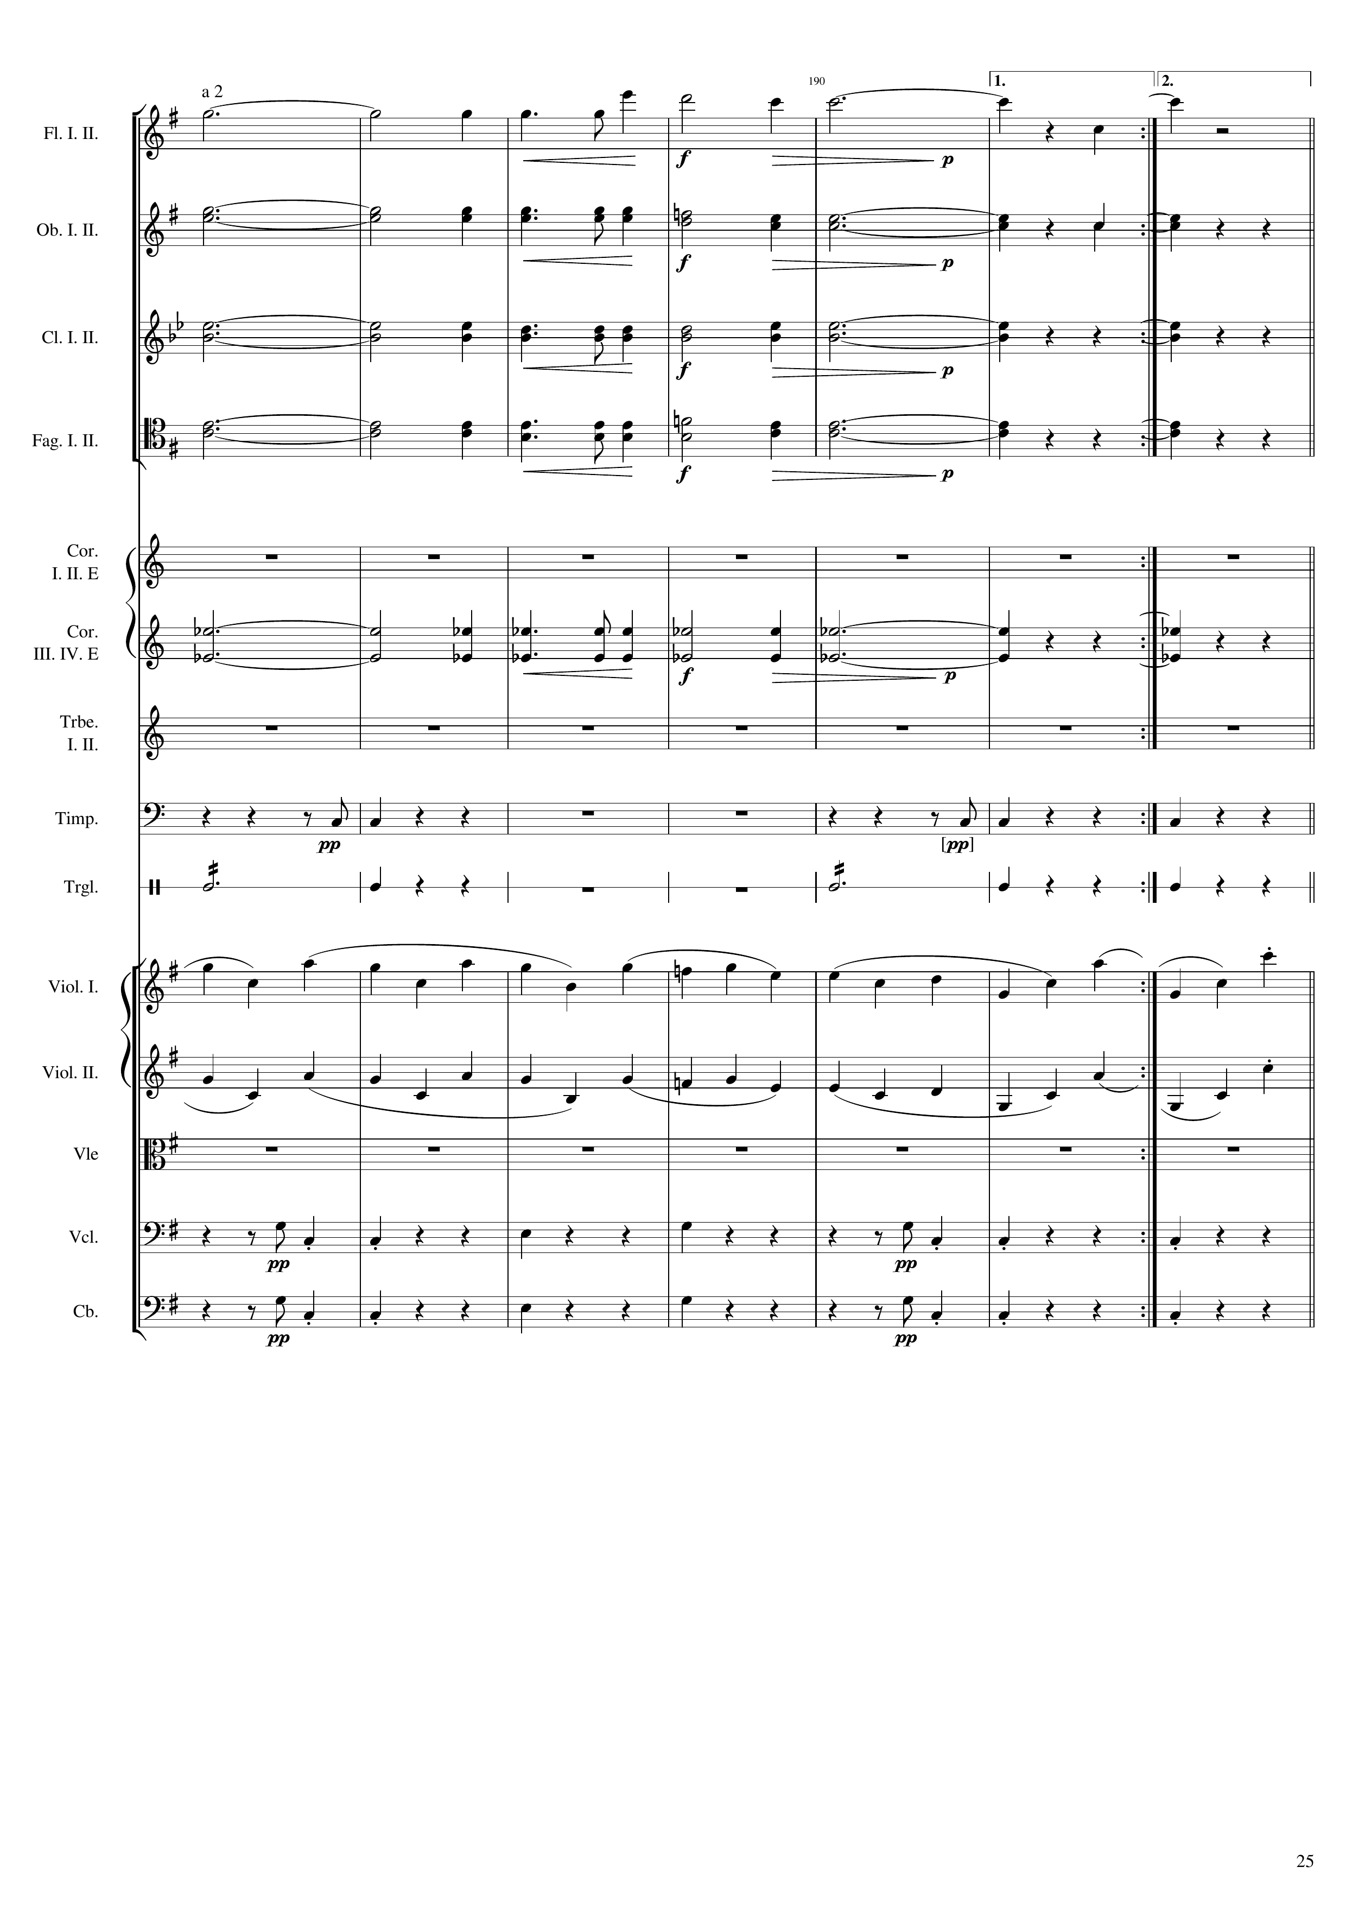
反覆16-1小節
266th bar
795
mel
mel
rhythm+harm
rhythm+harm
rhythm+harm
rhythm
rhythm
mel+rhythm
mel
mel+rhythm
mel
rhythm
rhythm

Slide 26
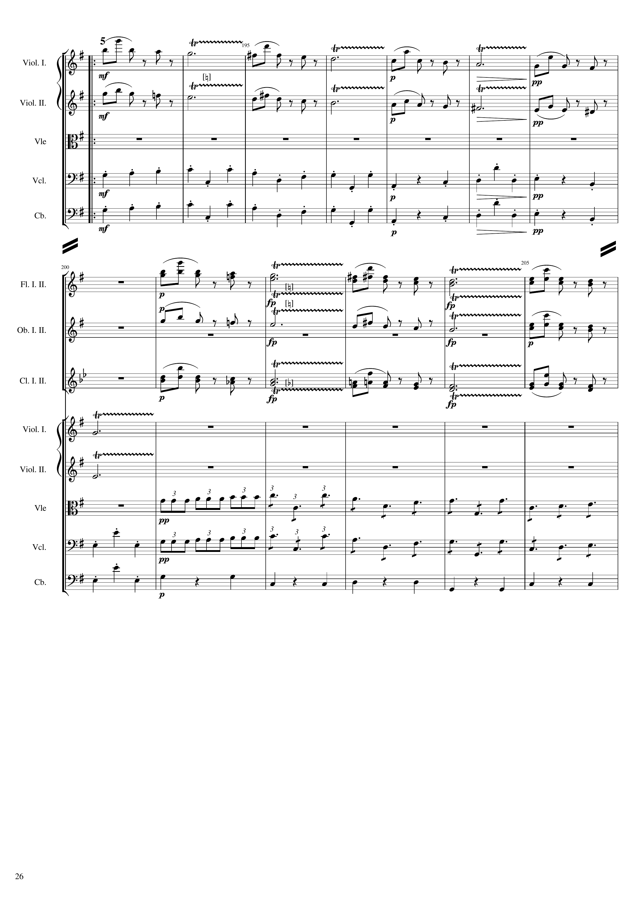
798
267th bar
939
mel
mel
rhythm
rhythm
822
mel
mel
mel
mel
mel
rhythm
rhythm
rhythm

Slide 27
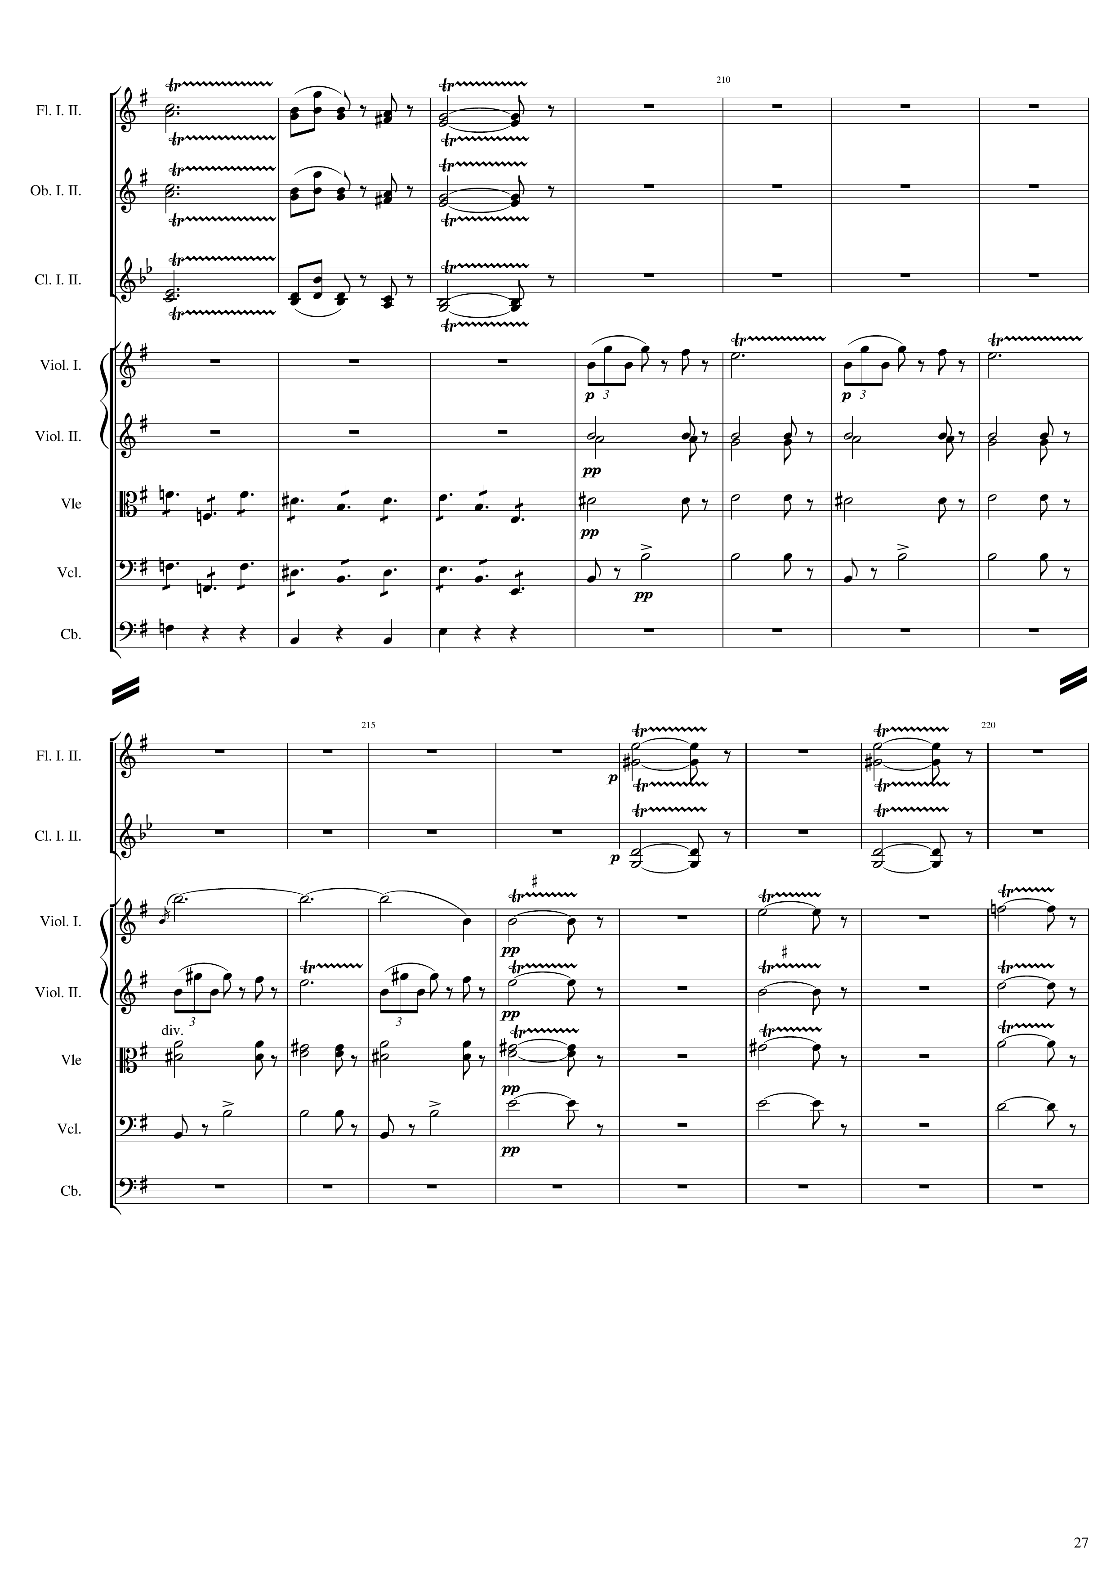
846
mel
mel
mel
mel
rhythm
rhythm
rhythm
rhythm
rhythm
rhythm
867
mel
mel
mel
mel
harm
mel
mel
mel
mel
mel
mel
mel
mel
rhythm
mel
mel
mel
rhythm
mel
mel

Slide 28
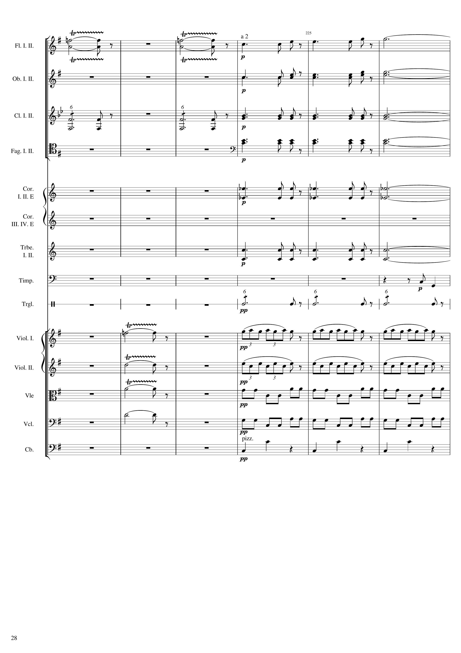
891
mel
mel
mel
mel
mel
mel
rhythm+harm
rhythm+harm
rhythm+harm
rhythm+harm
rhythm
rhythm
mel
mel+rhythm
mel
mel
mel+rhythm
mel
mel+rhythm
mel
mel+rhythm
rhythm

Slide 29
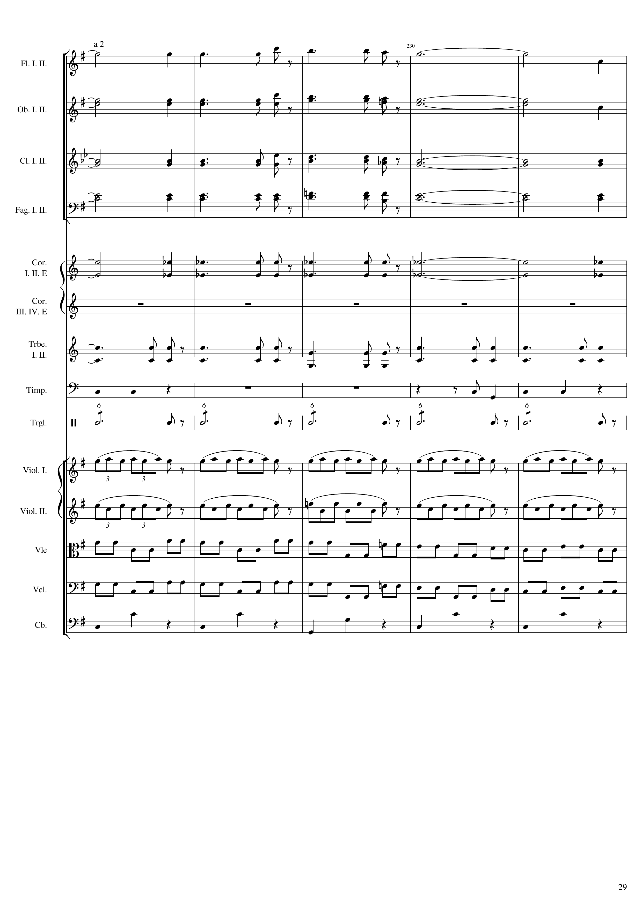
mel
mel
mel
mel
mel
mel
rhythm+harm
mel
rhythm+harm
rhythm+harm
rhythm+harm
rhythm+harm
rhythm
rhythm
mel+rhythm
mel+rhythm
mel+rhythm
mel+rhythm
rhythm

Slide 30
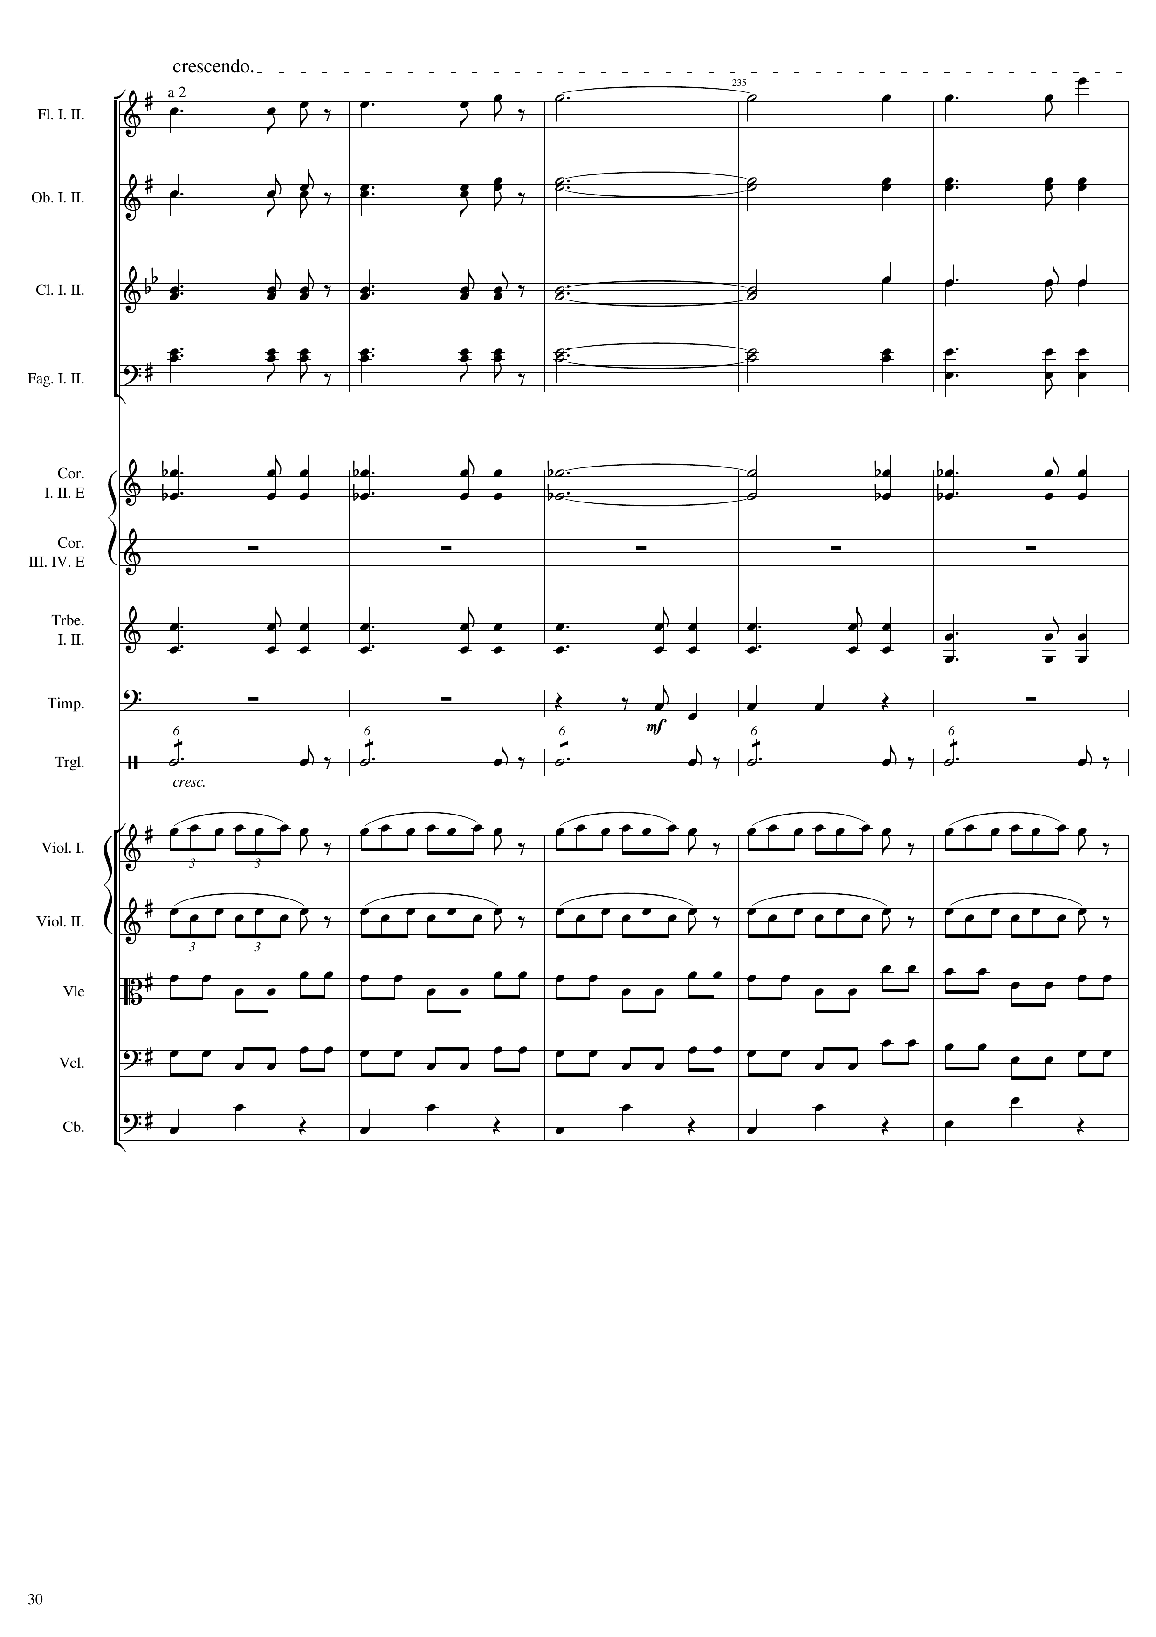
mel
mel
rhythm+harm
rhythm+harm
rhythm+harm
rhythm+harm
rhythm
rhythm
mel+rhythm
mel+rhythm
mel+rhythm
mel+rhythm
rhythm

Slide 31
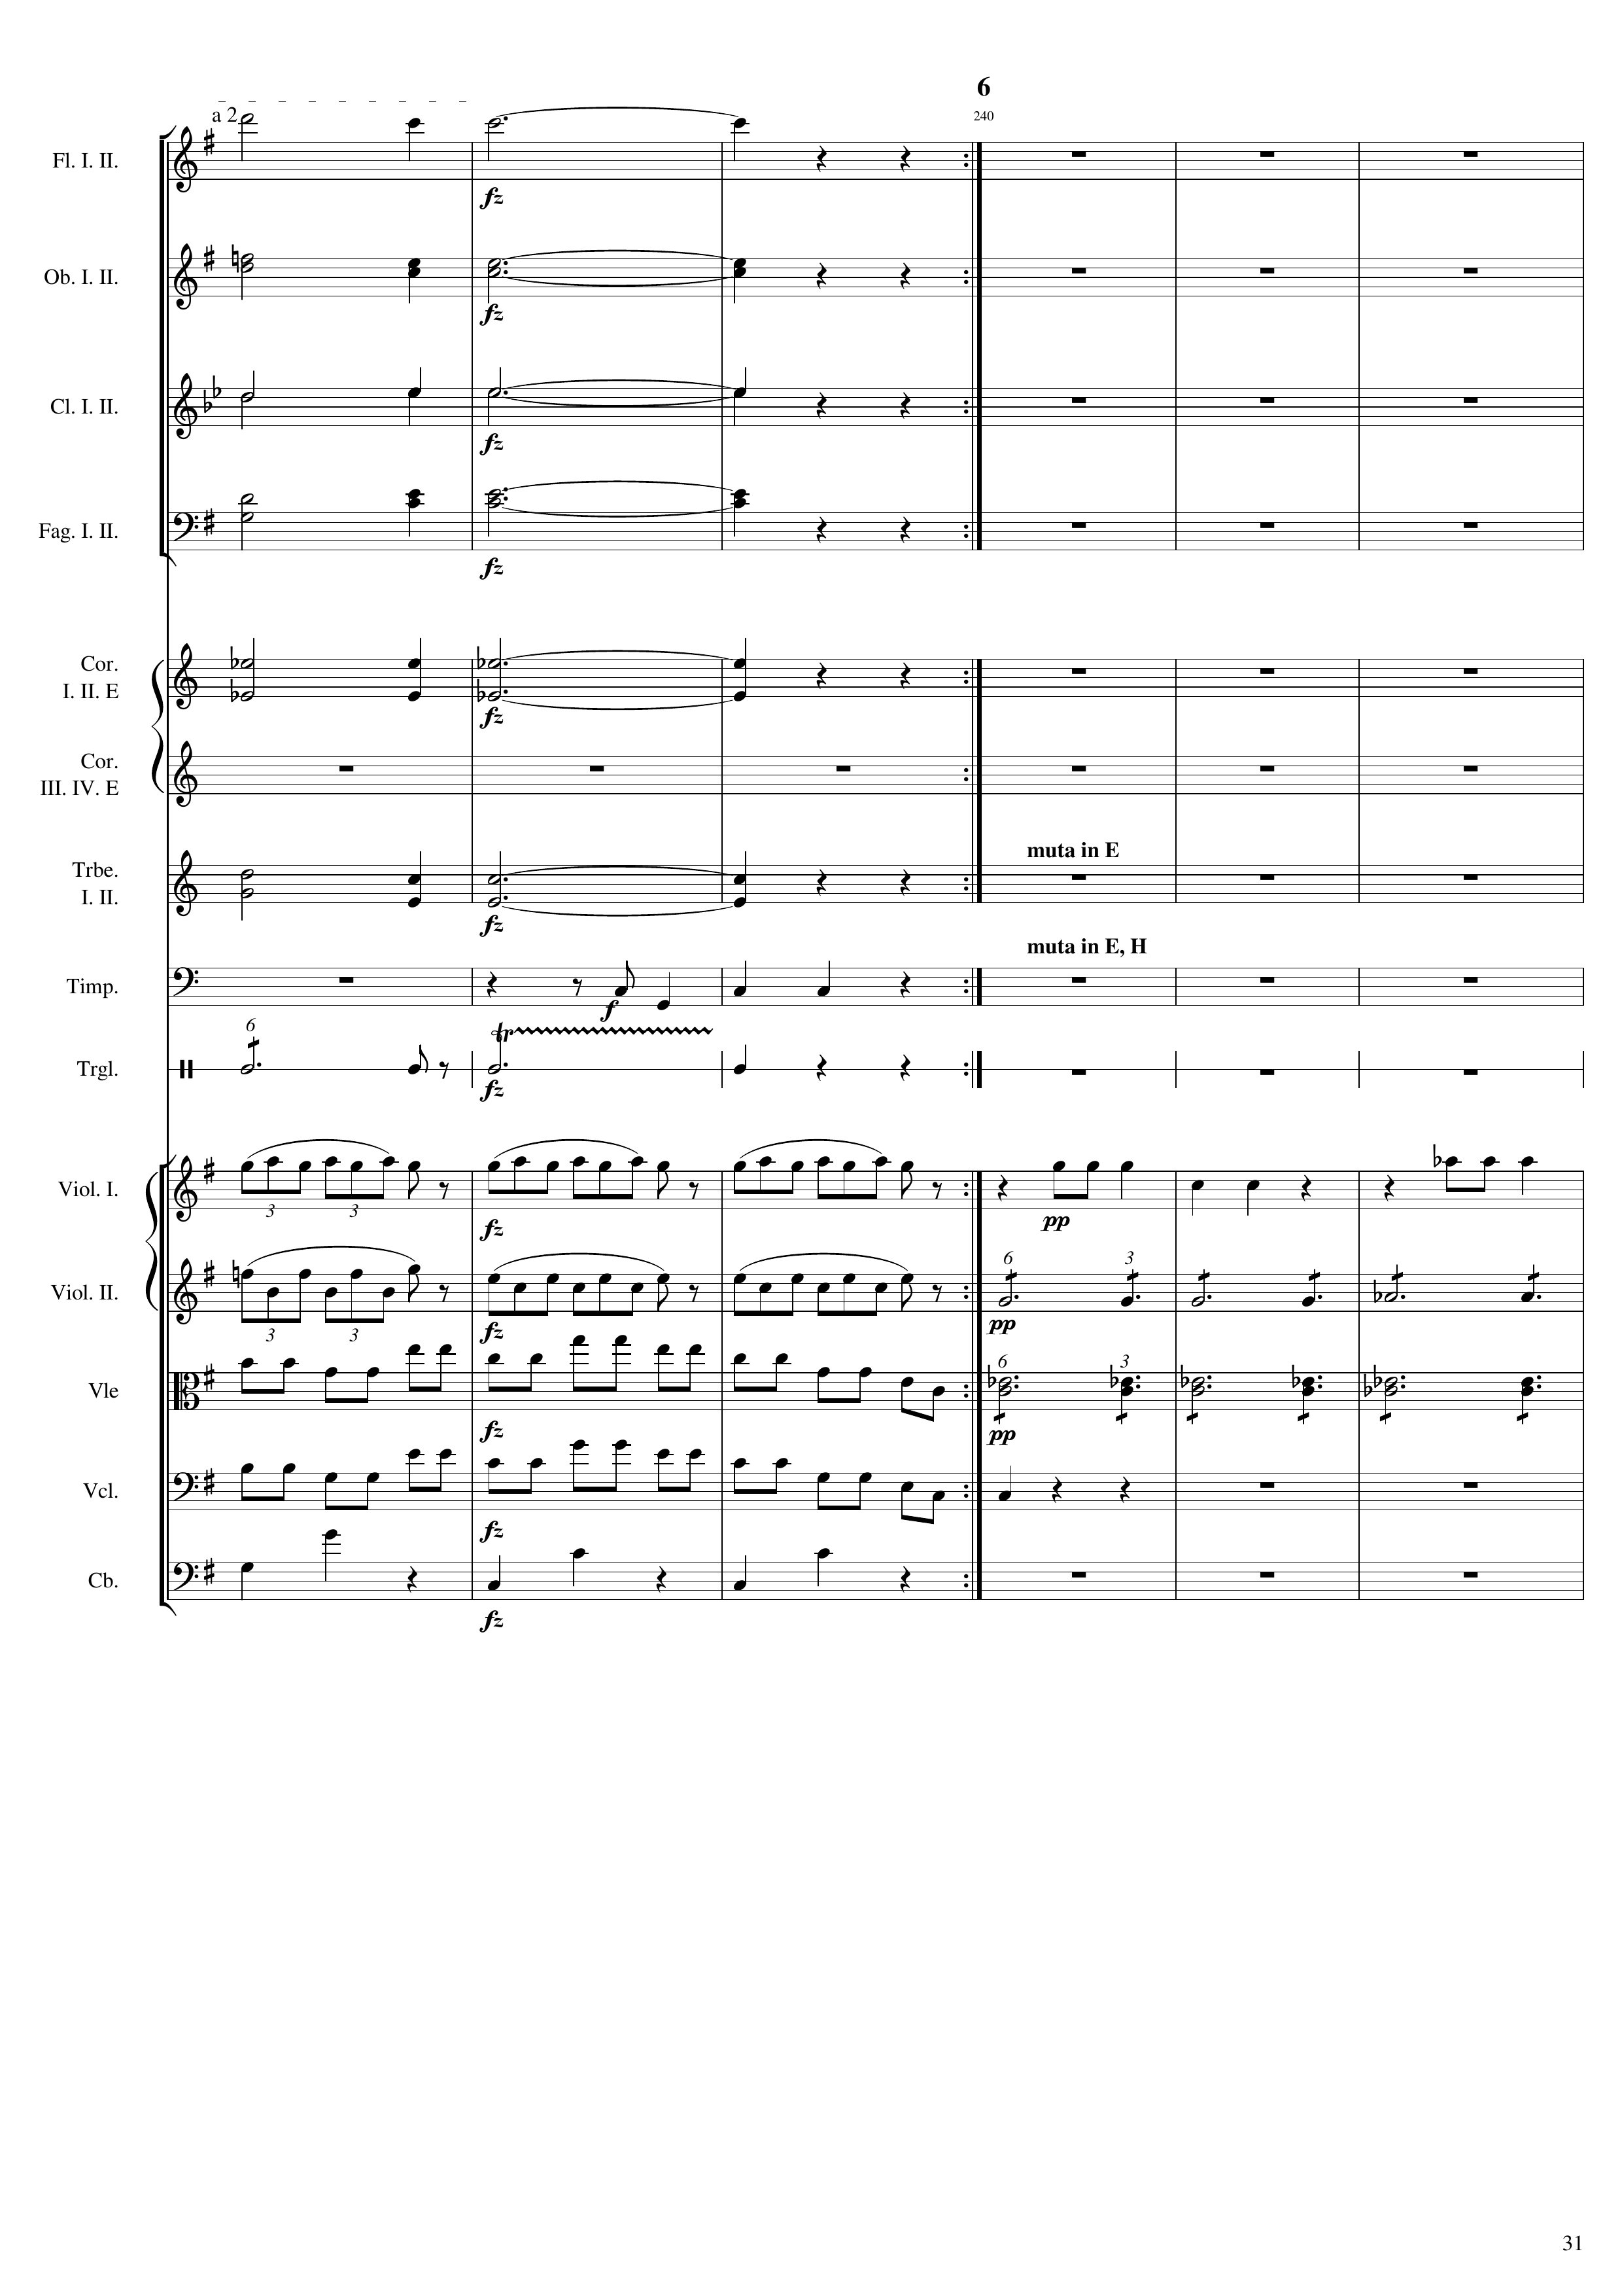
反覆47小節
938
1080
mel
361th bar
mel
rhythm+harm
rhythm+harm
rhythm+harm
rhythm+harm
rhythm
rhythm
mel+rhythm
mel
mel+rhythm
rhythm+harm
mel+rhythm
rhythm+harm
mel+rhythm
rhythm

Slide 32
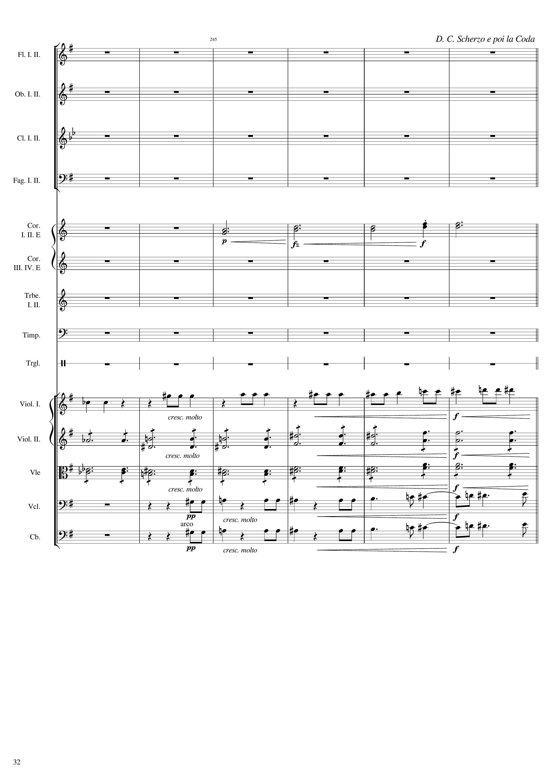
1095
369th bar
1107
反覆141 bars
harm
mel
rhythm+harm
rhythm+harm
rhythm+harm
rhythm+harm

Slide 33
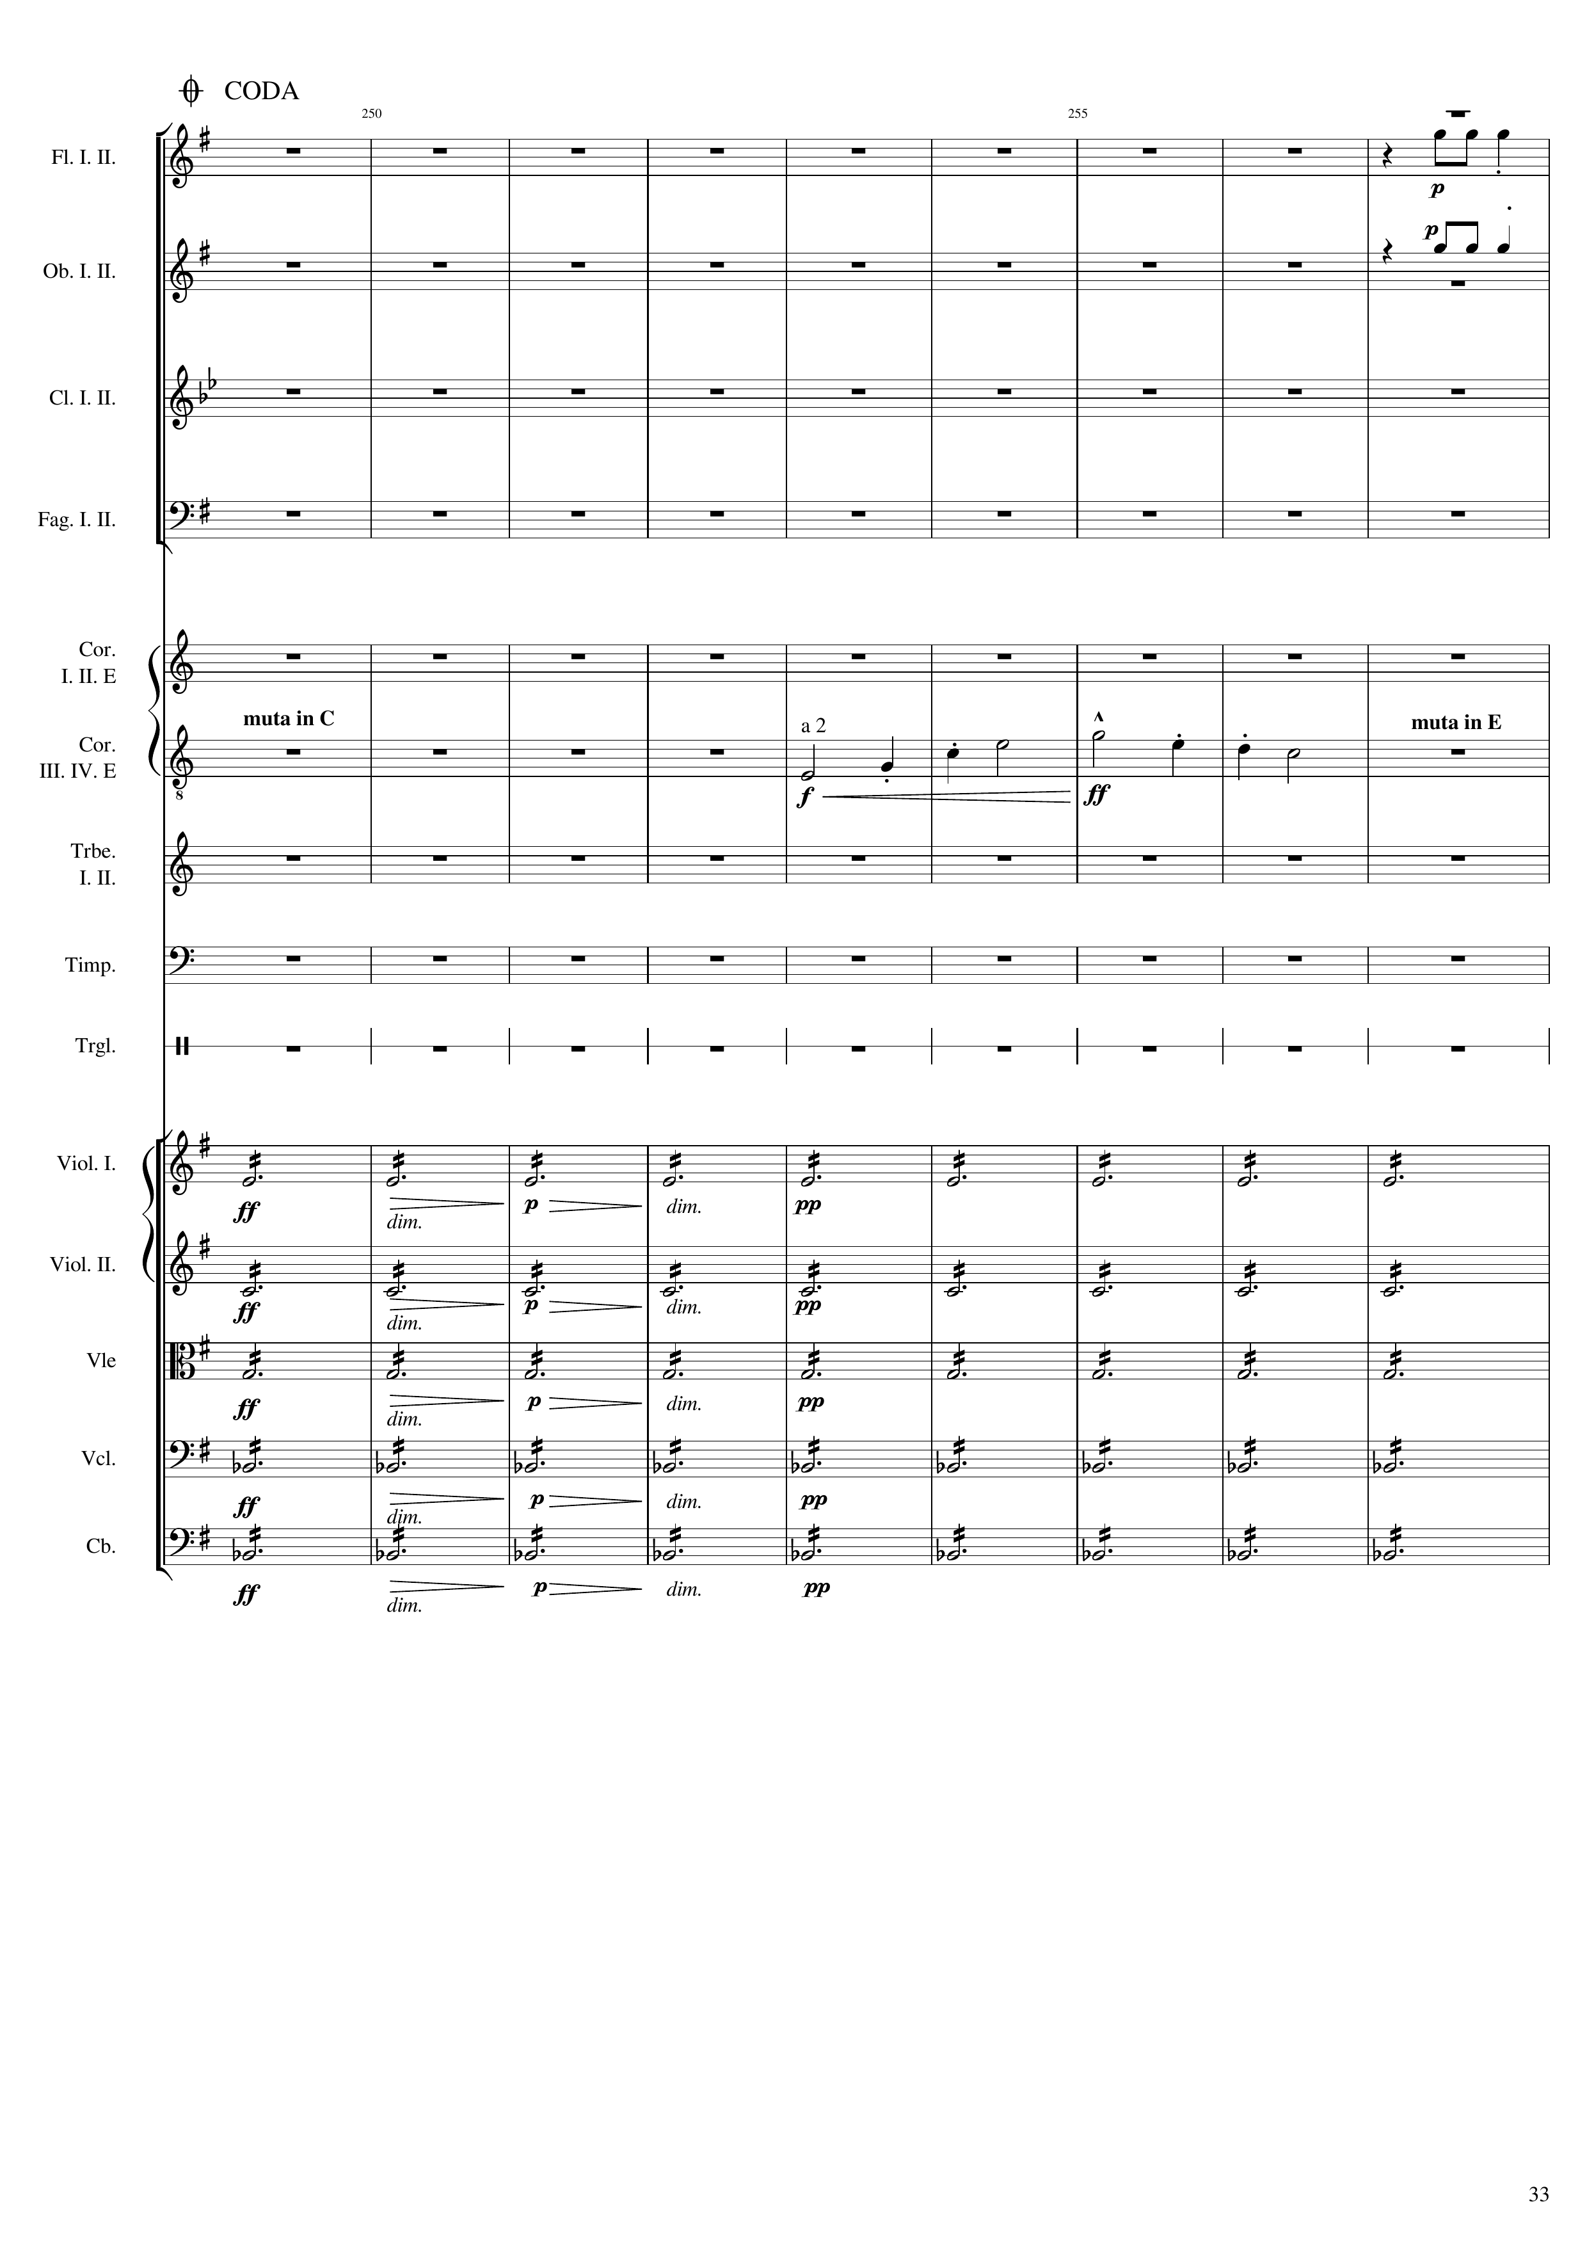
1530
511th bar
mel
mel
mel
harm
harm
harm
harm
harm

Slide 34
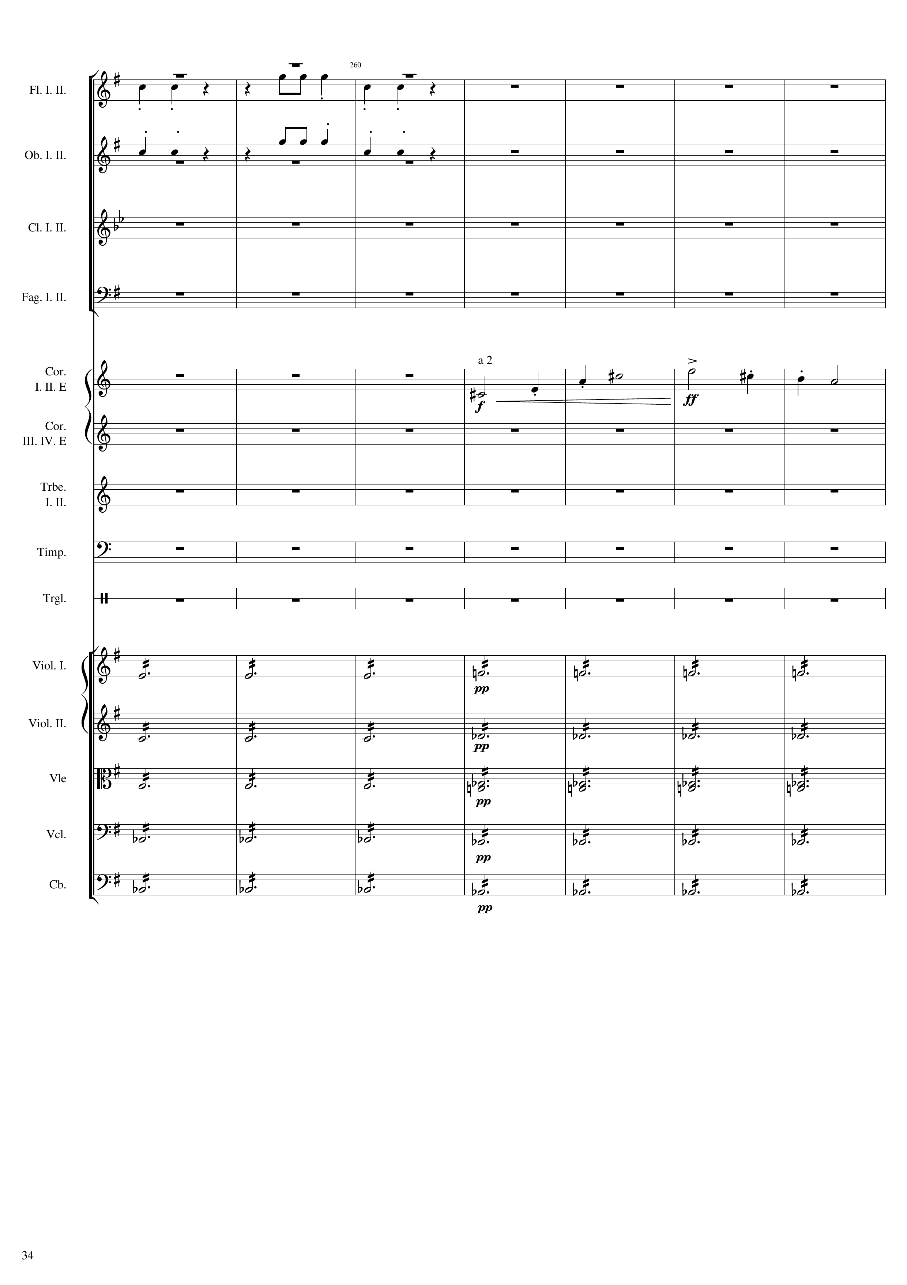
mel
523th bar
mel
mel
harm
harm
harm
harm
harm

Slide 35
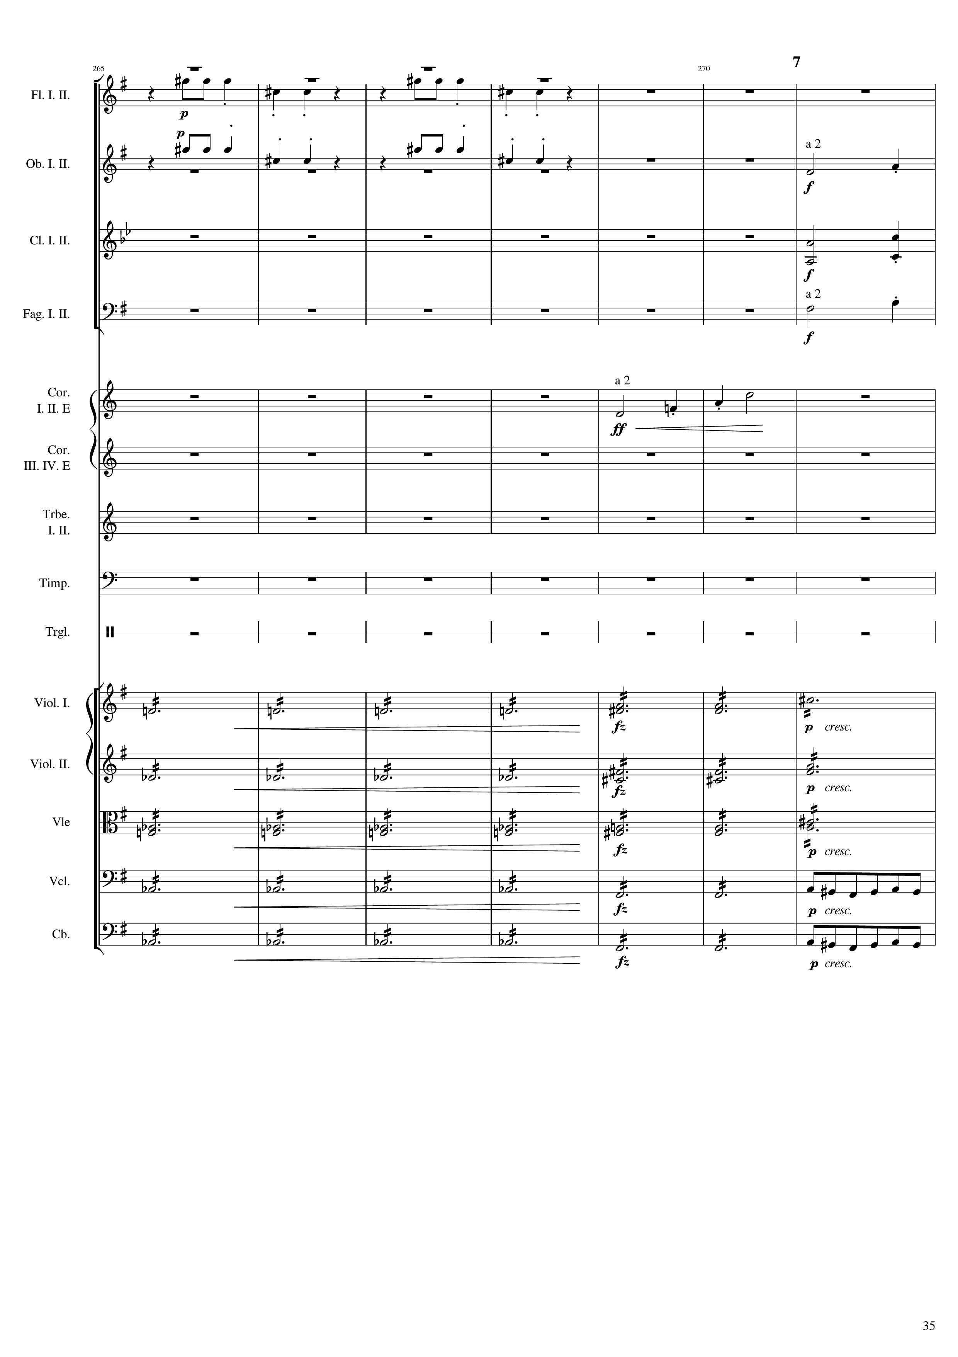
mel
531th bar
1596
mel
mel
mel
mel
mel
harm
harm
harm
harm
harm
harm
harm
rhythm
harm
rhythm

Slide 36
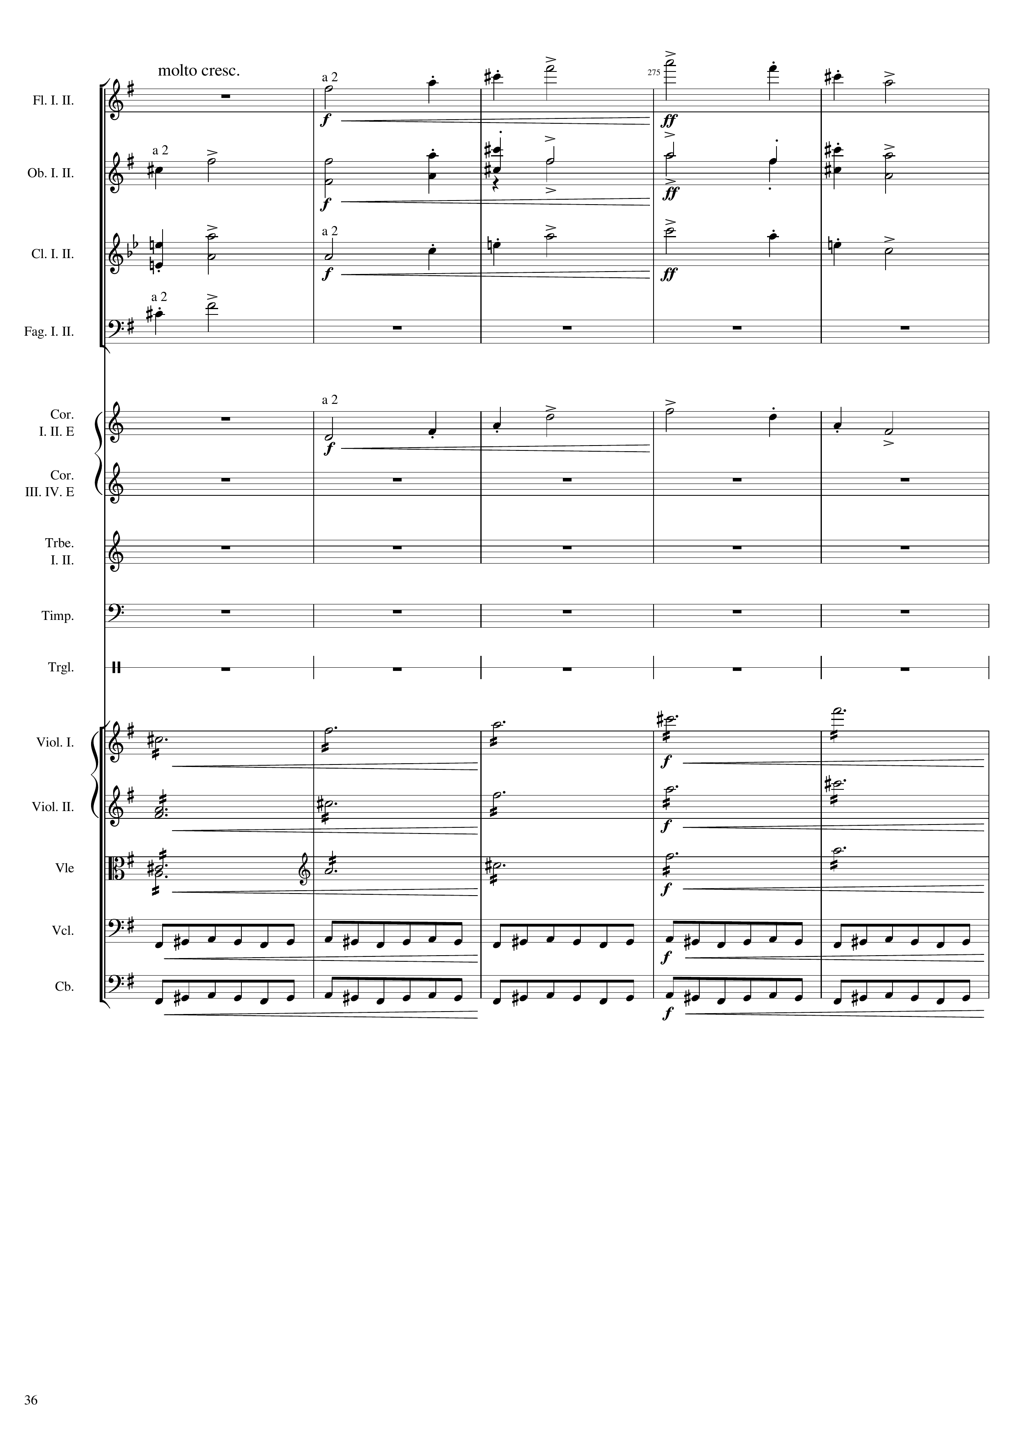
mel
mel
mel
mel
mel
mel
mel
harm
harm
harm
rhythm
rhythm

Slide 37
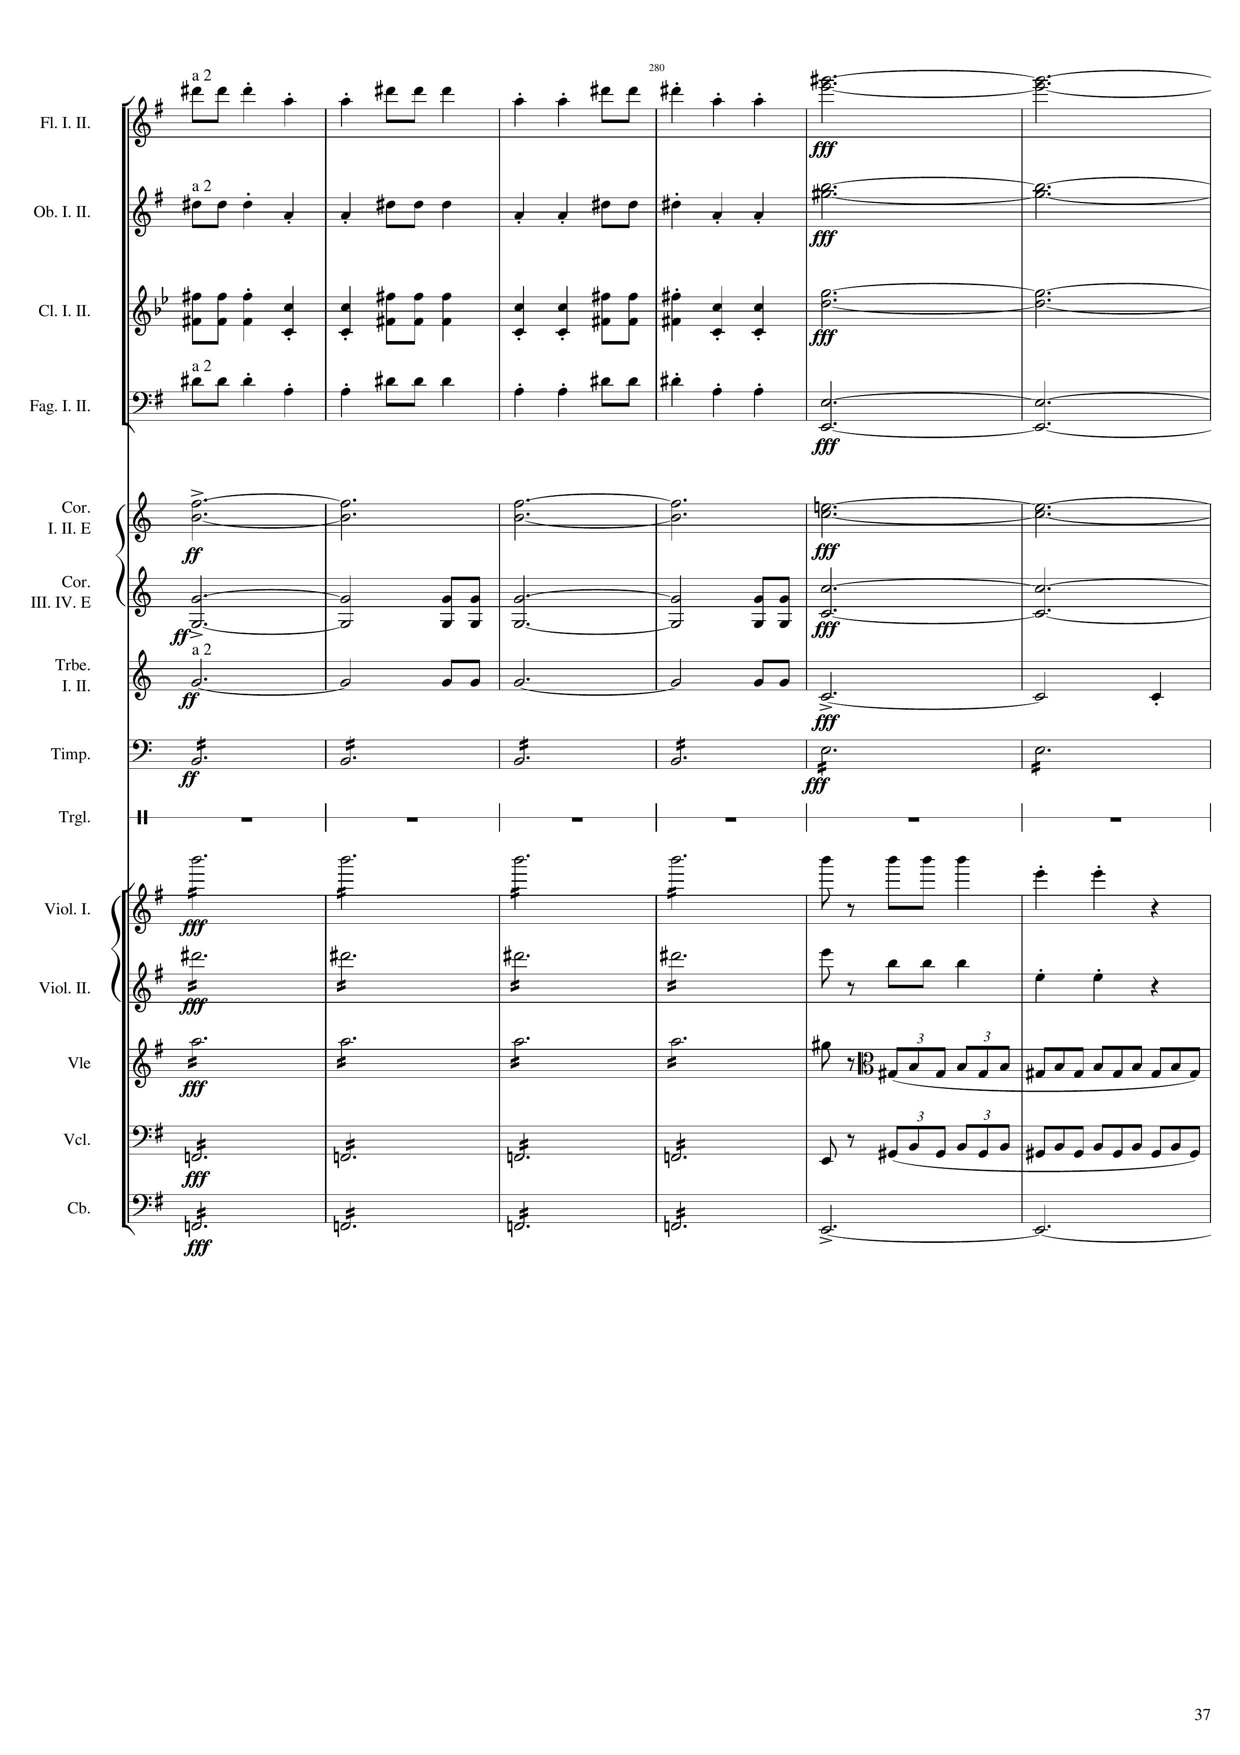
1626
543th bar
mel
harm
mel
harm
mel
harm
mel
harm
harm
harm
mel
harm
mel
mel
rhythm
rhythm
harm
mel
harm
mel
harm
rhythm
harm
rhythm
harm
harm

Slide 38
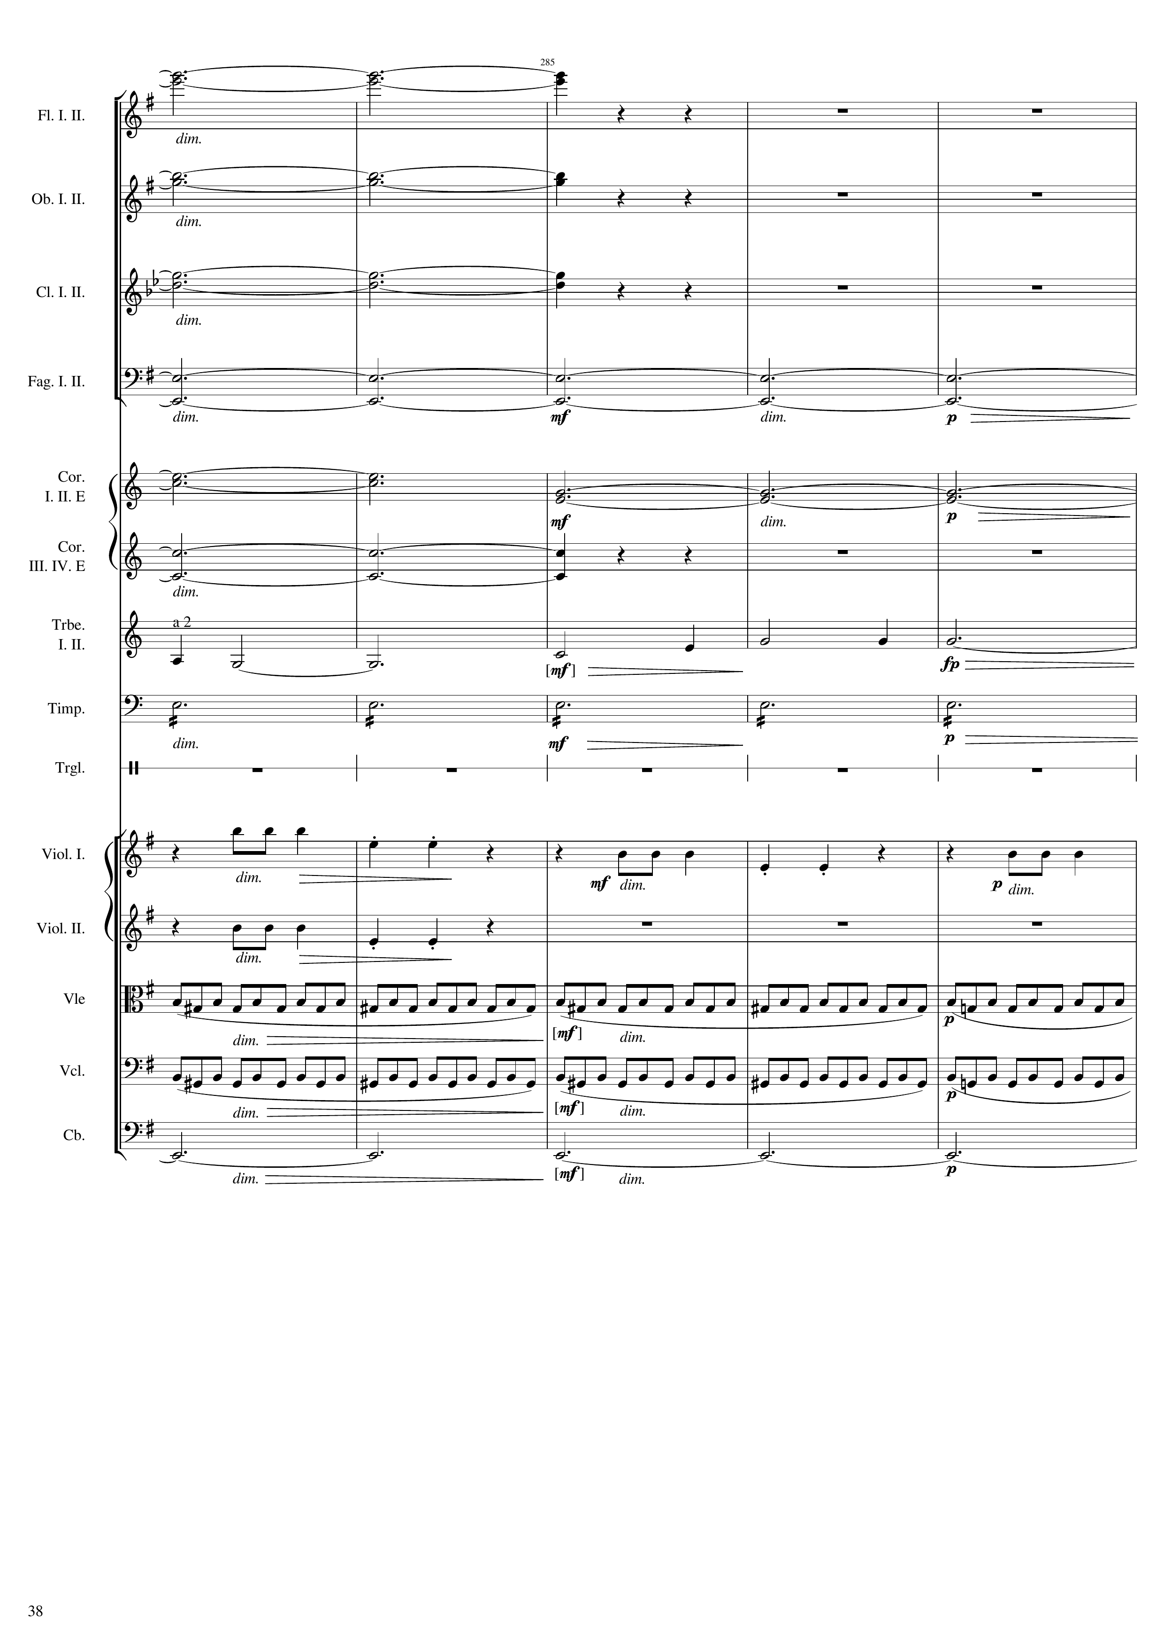
1638
harm
547th bar
harm
harm
harm
harm
harm
mel
rhythm
mel
mel
mel
rhythm
rhythm
harm

Slide 39
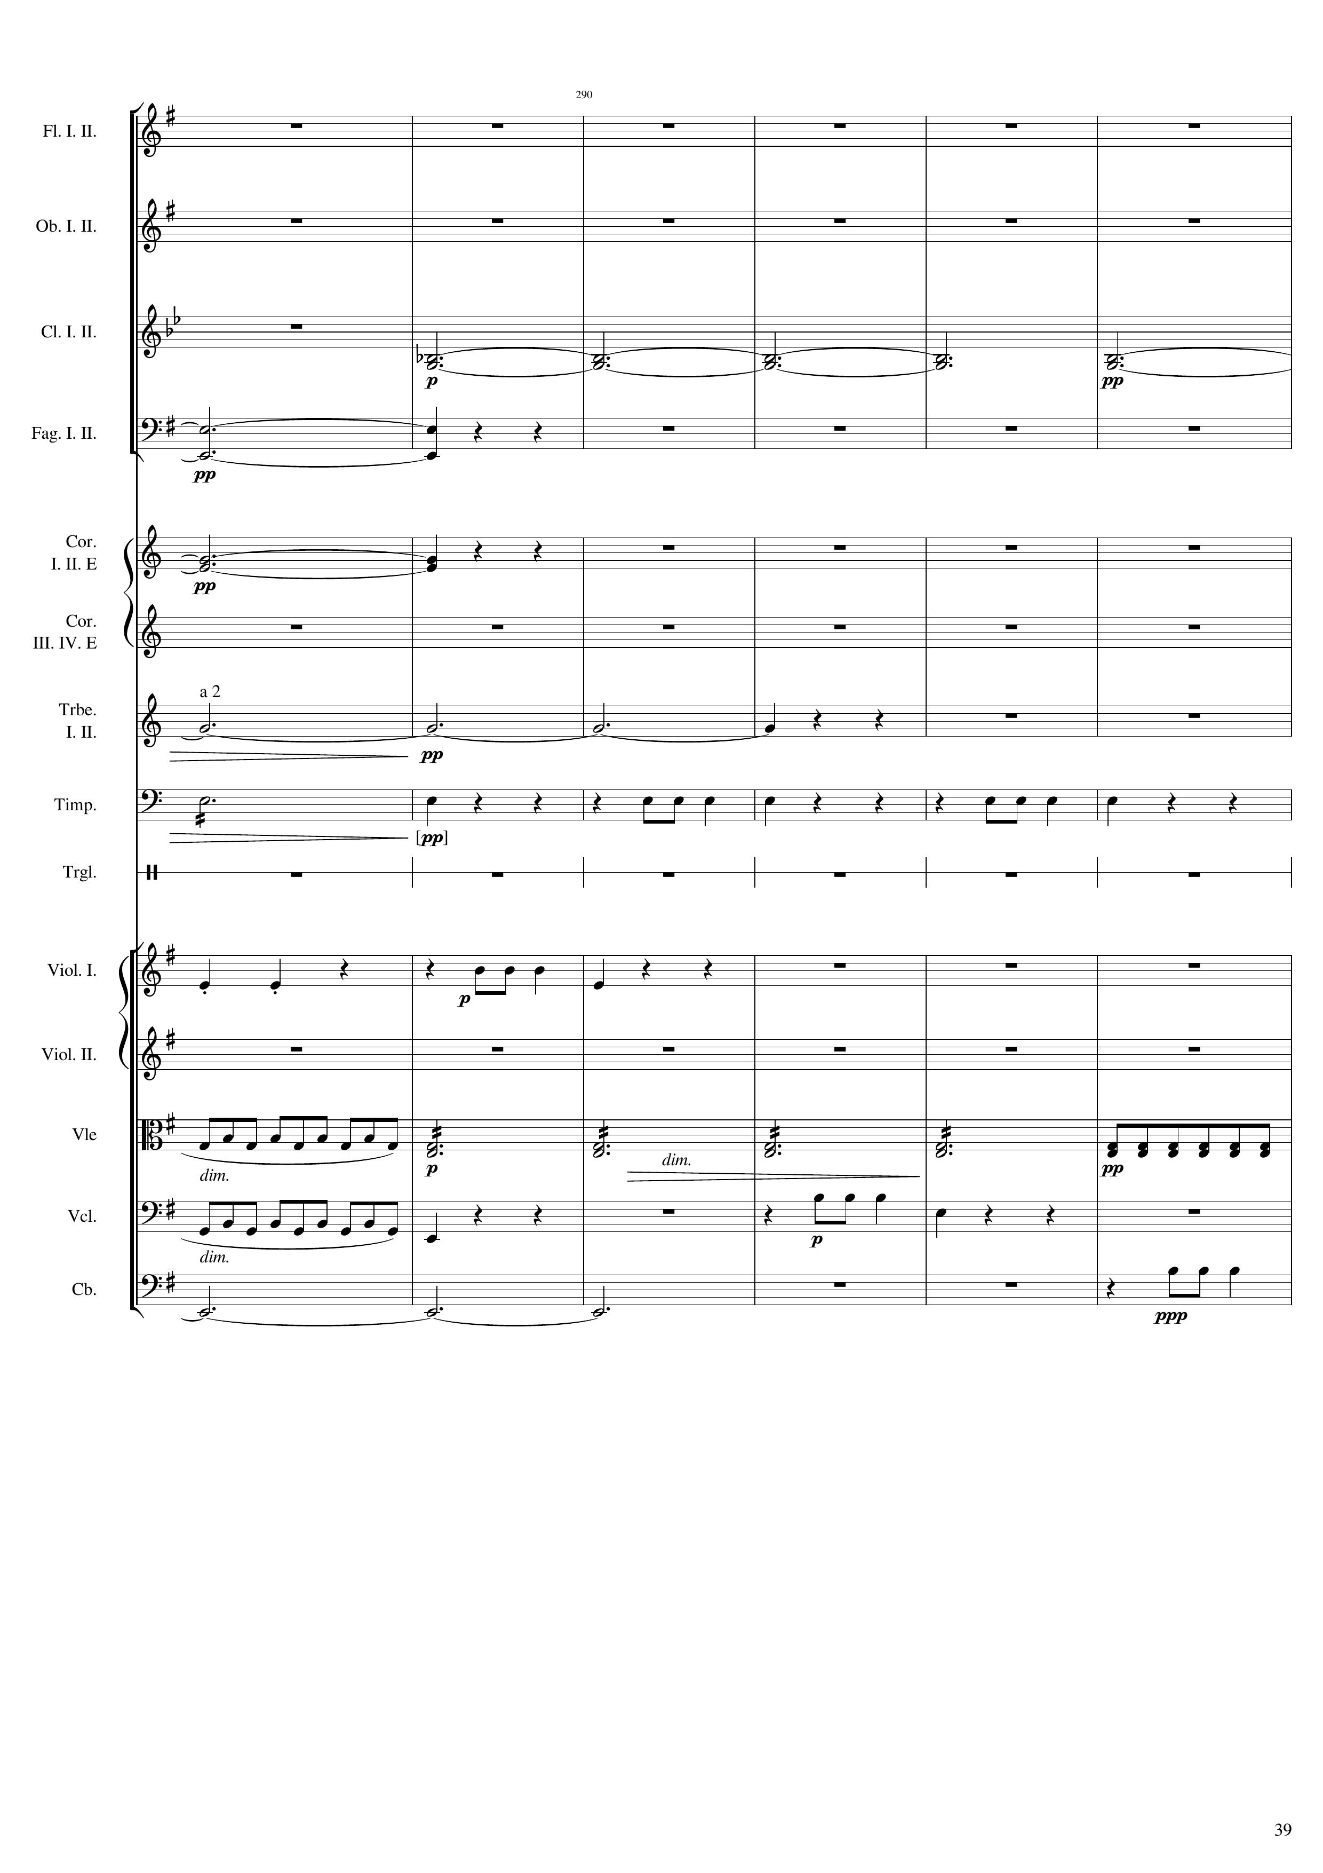
1650
551st bar
harm
harm
harm
mel
rhythm
mel
rhythm
harm
rhythm
rhythm
mel
harm
mel

Slide 40
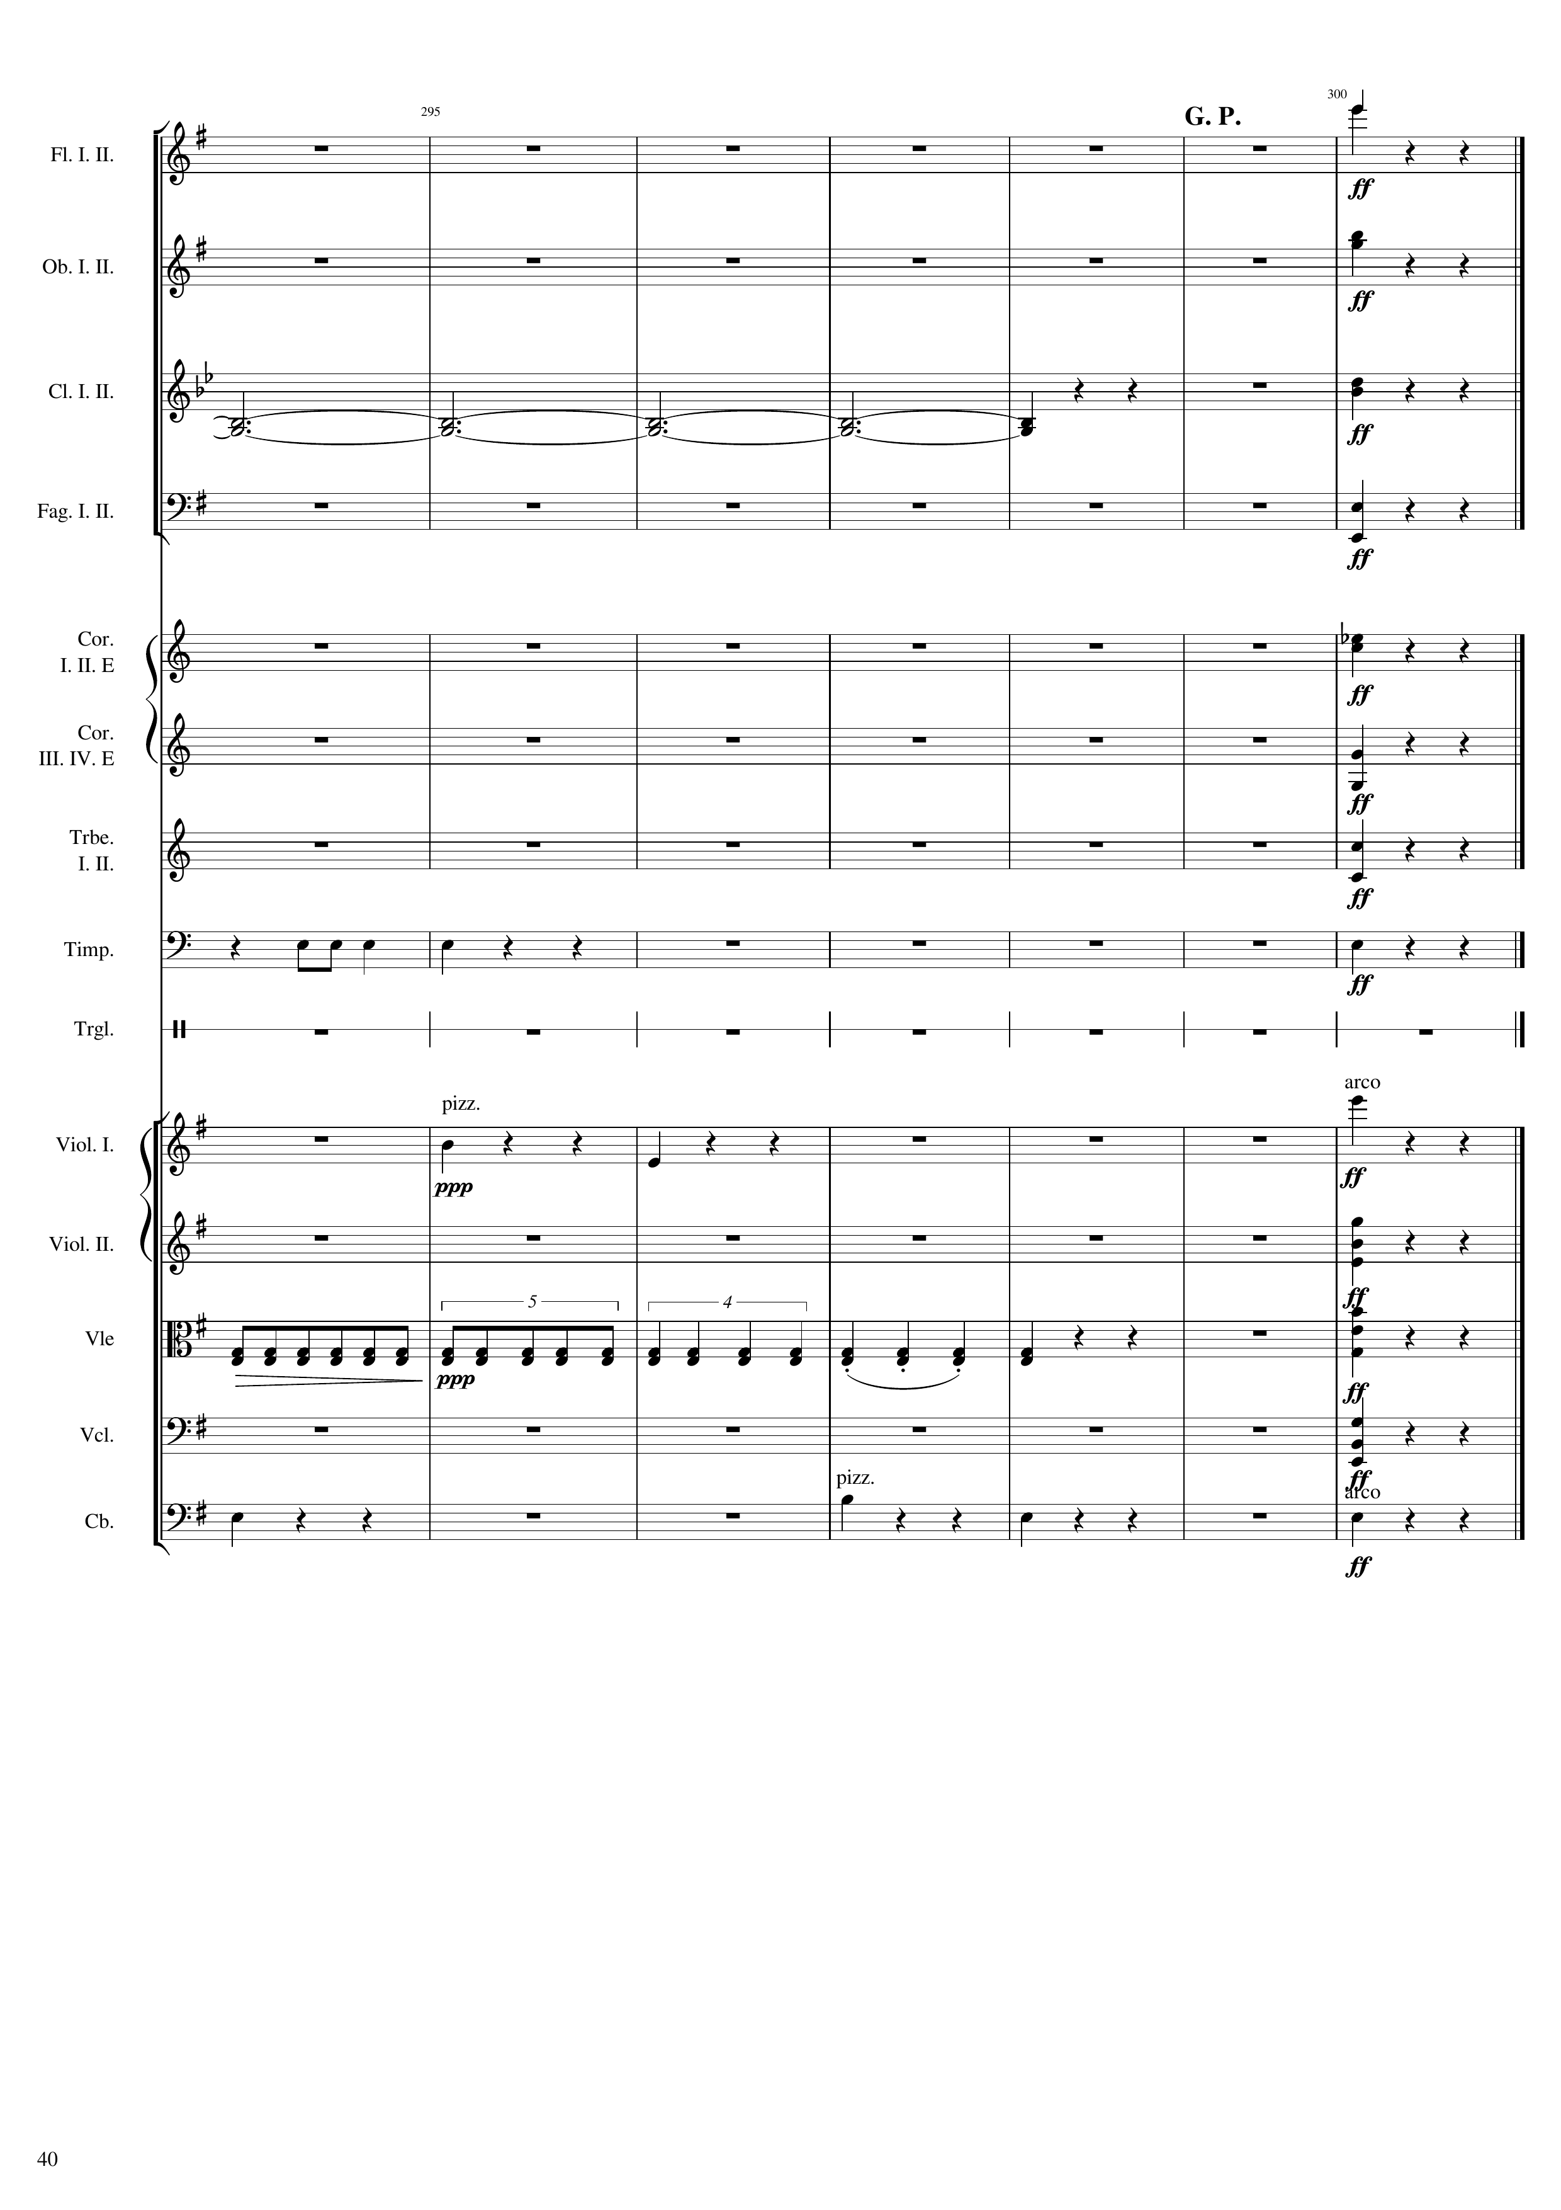
557th bar
562nd bar
1668
rhythm+harm
rhythm+harm
harm
rhythm+harm
rhythm+harm
rhythm+harm
rhythm+harm
rhythm+harm
rhythm+harm
rhythm+harm
rhythm
rhythm+harm
rhythm
rhythm+harm
rhythm+harm
rhythm
rhythm+harm
rhythm+harm
mel
rhythm
rhythm+harm

